Slide 1
Building Apps and Solutions with Microsoft Teams
Notes:
Course title slide

Slide 2
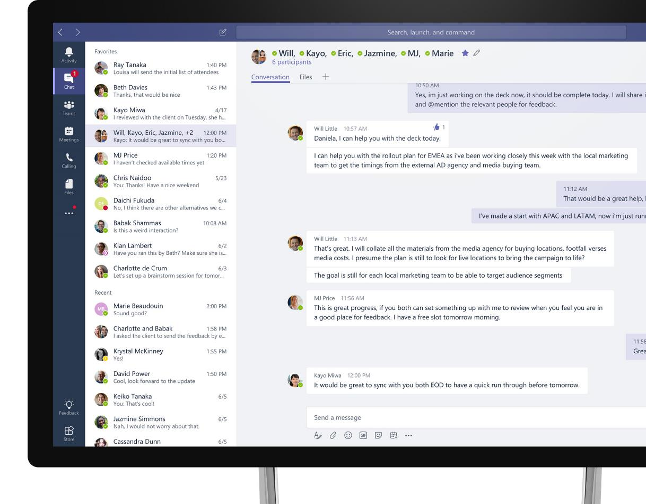
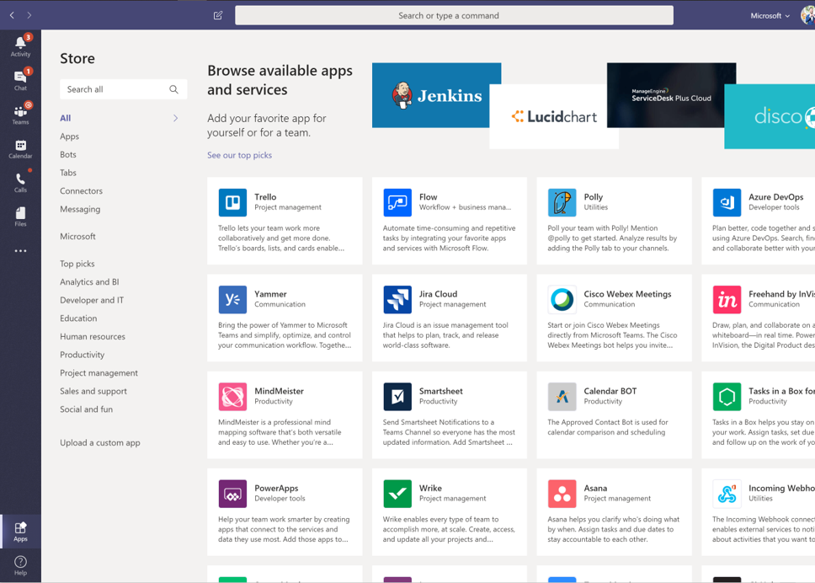
Microsoft Teams
The hub for teamwork in Office 365
Communicate
through chat, meetings & calls
Collaborate
with deeply integrated Office 365 apps
Customize & Extend
with external apps, automation, process flows, and custom apps
Work with confidence
enterprise level security, compliance, and manageability
Notes:
[This is an animated slide. Please show it in presentation mode]
[MAIN POINT TO LAND]
Microsoft Teams is a hub for teamwork, a chat-based workspace that enables teams to be more productive by giving them a single and secure location that brings together everything a team needs: chats, meetings, calls, files, and tools. Microsoft Teams is one place for all the needs your teams have.
Microsoft Teams delivers on four core promises to create a digital workspace for high performing teams.
[COMMUNICATE]
First, Microsoft Teams solves for the communication needs of a diverse workforce.
Since preview, Microsoft Teams has evolved to a complete meetings and calling solution, incl. chat, voice and video, as we have completed our roadmap for bringing Skype for Business Online features and functionality into Teams. You can use Teams for informal 1:1 or group chats – directly on your phone if you’re on the go. Or you can have an open conversation in a channel. This enables people to share information in a transparent way to accelerate decision making. And it's super easy to move from a chat into a face to face meeting, helping you to bridge geographical barriers.
[COLLABORATE]
When it comes to collaboration, the deep Office integration enables today’s multigenerational workforce to use the Office apps they are familiar with and love - Word, Excel, PowerPoint, OneNote, SharePoint, Planner, even Power BI - right within the context of Teams.
You can avoid email attachments and having to search for the latest version of a document. Teams brings all the Office 365 services together – so that you can easily share and co-author files.
[CUSTOMIZE]
Many of you use other services than Office 365 as well which results in you having to jump between and spend time in disparate experiences. We built Teams to be the hub for all the services and tools your teams use on a day to day basis. So, you can customize Teams with tabs, connector and bots to include the apps and services you need - <mention relevant 3rd party apps like GitHub and Trello>. We have also created an extensible platform, to enable building apps and to integrate with business processes.
And for Firstline workers, Teams provides an additional set of capabilities including schedule management.
[WORK WITH CONFIDENCE]
Microsoft Teams comes with the enterprise grade security, compliance and manageability that you expect from Office 365 which customers tell us is a huge value add for them.
------
And that product is Microsoft Teams.
And back to that Satya quote we shared earlier about Microsoft as a platform company,
Core to the value of Teams is also the platform that it’s built upon.
(click slide to build)
which enables you to customize & extend your experience.
Today, we will discuss how to unleash the real power of Teams to and create experiences
that help solve the communication challenges we mentioned earlier,
and deliver experiences that most organizations have only dreamt about.
Now, why is a platform important? Because while every team is unique,
one thing that is consistent is that every team will need a variety of apps and tools to get their work done.
Since there is no such thing as a universal tool for work, the extensibility of the Teams platform
delivers a universal hub for teamwork to infuse all those tools, together.
Let us show you what we mean by infusing your tools, together.

Slide 3
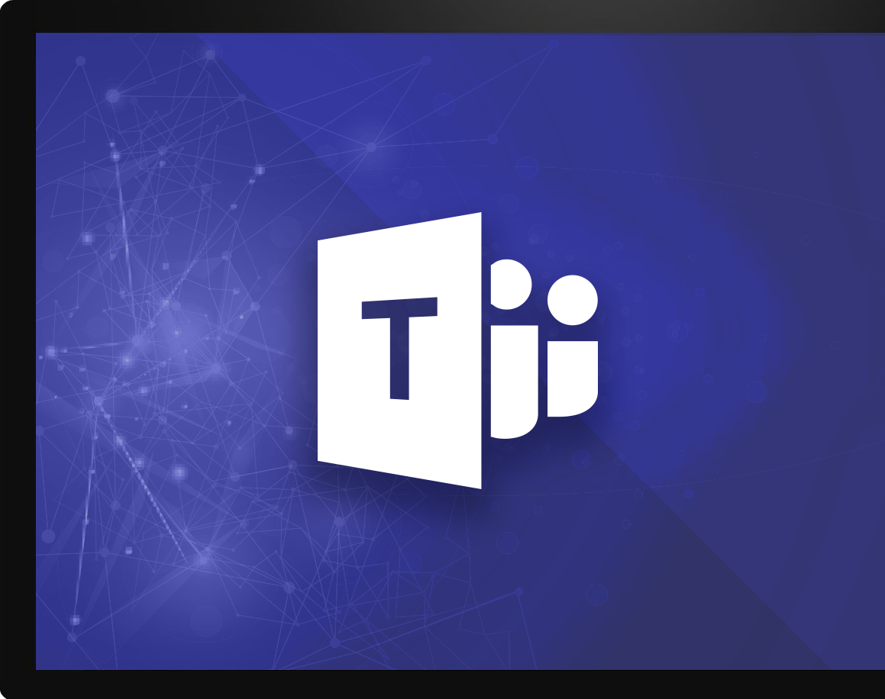
Microsoft Teams Platform
build experiences that people love
Communicate
through chat, meetings & calls
Collaborate
with deeply integrated Office 365 apps
Work with confidence
enterprise level security, compliance, and manageability
Customize & extend
Gain context without switching context
Meet your people where they are
Tailor your teamwork
with 3rd party apps, processes, and developer tools
Notes:
Talk track: And core to that are the investments we’ve made in the Teams Platform, allowing users & developers alike to customize and build on Teams, in order to deliver experiences that your people & customers LOVE.
And when it comes to the platform and the value that our customers are seeing from it, we are seeing three distinct categories emerging:
Gain context without switching context: Teams pillar of integration (the single hub for Office) but also the ability to simply curate your experience so you reduce the information overload you get every day and focus on the content that's most relevant to you to get your job done, better. INFUSION
Meet Your people where they are: Bring together all the apps and tools your organization is already using, into one user interface. Guess what, for IT that means better & easier management, reduced security threats, and more time you can spend on valuable, forward-looking projects. For end users, #1 just got even better. (opportunity to share a 3rd party apps slide here)
Tailoring your experience: to me, this delivers superpowers to people through proactive intelligence. This is the core to the extensibility of the Teams platform. Deliver intelligent experiences using our APIs and/or our partner community that:
First: make the most difficult and time-wasting tasks at work, easy
Thereafter: drive intelligence to your people that allows them to understand how they add more value to the organization, and then deliver it more efficiently & quickly

Slide 4
Apps In Teams
1st Party Apps
3rd Party Apps
Custom Apps
Developed by Microsoft
Office 365 or Office workloads
Enable better together scenarios
Not built by Microsoft
Popular work applications
Enabled in central location
Built by your organization
Custom for business needs
Accessible by users in Teams
Notes:
We start with a quick overview of the types of apps in Teams.
1st Party Apps are those that are published by Microsoft. These are familiar apps like Word, excel powerpoint, and other apps like Bing News, Flows, Dynamics 365 etc.
Other apps are published by other 3rd party vendors. You’ll find several of them on the Teams in-app store.
<Show the store in the app at this point>
Company Apps:
The Microsoft Teams Company App Catalog lets you distribute your line-of-business applications that were built specifically for your organization and that you rely on to complete critical business functions to your users.
Custom apps are apps that are specific to your organization, built and used specifically for users in your organization. Here’s where you’ll find apps that are specific to Microsoft as a company. These apps have been published by the global admins over at the Microsoft IT department
<Show the Microsoft apps in the Teams app store?
With every IT Professional’s focus on security and privacy for cloud or SaaS apps, what controls are we providing organization admins to allow or block these apps? How do admins disable company specific apps if they find issues or bugs with them?

Slide 5
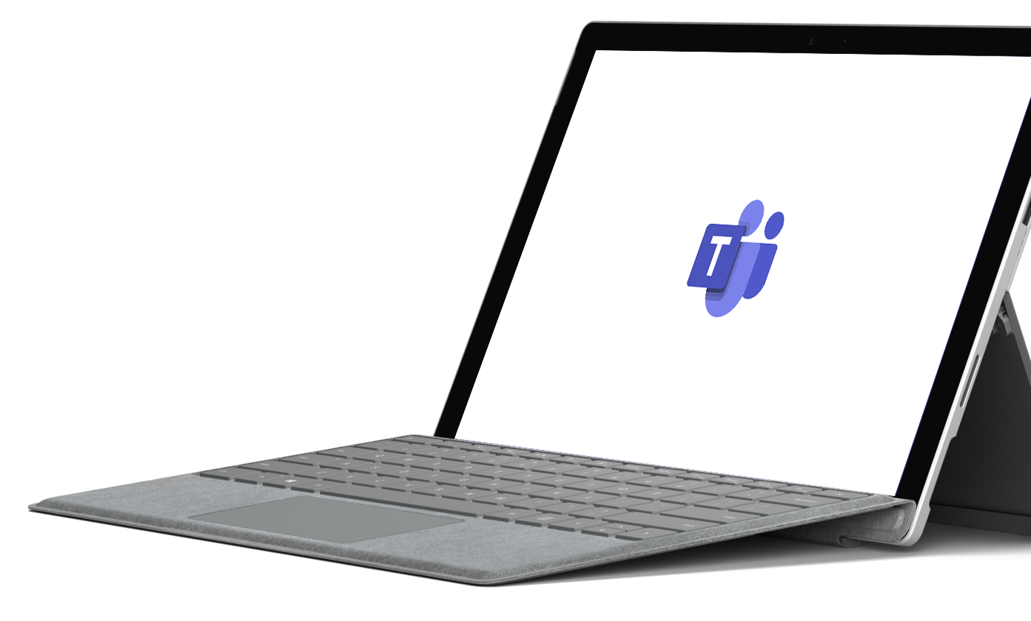
So, where do you start?
Notes:
No that you understand the basics of what’s possible, let’s get into the details around why you want to build for Teams and where you can start

Slide 6









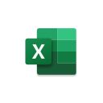








Evolve how your people work, with the tools they need
Vertical solutions
Healthcare
Manufacturing
Retail
Banking
Custom
Apps
Organization-based applications
Departmental tools
Employee resources
Support & info
Processes & workflow
Partner applications
Ready to use
Office 365
applications
Notes:
(first slide build is auto)
So one of the beauties of Microsoft Teams is that Teams really is the hub for where people get work done and so they want to make sure that all the tools they need are a part of Teams.
So they don’t have to change contacts and we think of this as two different types of applications.
The first part of customizing and extending Teams is bringing together all the Microsoft Office applications you know and love, allowing you to reduce context switching and create conversations around content.
(click to build)
The second part of this infusion of tools is where we bring together all the other apps and services you need every day to get your job done, whether or not Microsoft built them.
Our Teams store currently has over 250 of our partner applications and integrations available today, and growing.
Just to clarify the point, these first two layers here are ready to use applications available for you
As soon as you download Teams, should your IT admins make them available to you.
(click slide to build)
Finally, this is where things get interesting. Microsoft Teams also gives you the ability to extend
Your experience to leverage the apps and services that your organization has built for you.
The tools you need to leverage every day as an employee to get work done and as part of your role.
We call these line of business applications.
Now, when you look at this picture, it’s exciting. Imagine a day where all your applications
(click to build slide)
not only show up in one single UI, but also work better together, allowing you to stay in the flow of your work.
That day is here and it’s time to deliver your people the modern workplace they deserve
And make their apps work for them

Slide 7
App scenarios across industries and horizontals…
Industry vertical
Airlines, transportation
Flight/route crew communication hub
Local crew shift management
Mining, oil, and gas
New location development
Daily quality monitoring and analysis
Manufacturing
Key accounts inventory, logistics
Change order services
Financial services
Proposal Manager for commercial banking
Content sharing with compliance
Government
Emergency/disaster response and recovery
Citizen service: permitting and licensing
Power and utilities
Field service real-time remote assist
Billing and customer management
Retail and consumer goods
Supply chain real-time collaboration
Shift, pricing, and inventory management
Healthcare
Patient care coordination
Telemedicine
Real estate and construction
Leasing office tenant management
Real estate customer engagement
Horizontal
Marketing
Brand partnership hub
Industry event planning
Marketing hub
HR
Recruiting tool
New hire onboarding and support tools
Project management
Billable hours management
Client engagement hub
Service desks
Self-service knowledge base
Customer service desk
Procurement center service
Firstline workers
Shift management
Remote worker task management
Notes:
These types of business solution opportunities around Teamwork are pretty much endless!
From airline, retail, healthcare, legal firm, real estate, different industries and different functions. You can envision with your customers, understand their business process and teamwork needs, and connect Teams to the tools and services they use everyday to help them fully realize Teams’ value. This purpose of this slide is to give you some ideas, to start thinking about what your customers need.

Slide 8


Microsoft Teams provides a powerful and extensible platform
Build apps using rich capabilities to empower your users in chat, channels, and personal workspace
Distribute and manage your app
Enterprise Developers
Upload to your organization’s app catalog
Tabs
Bots
Surface rich content within Teams
Help users get tasks done in conversations
ISVs Partners
Publish to AppSource to make available in the Teams app store
Messaging Extensions
Notifications
Allow users to query and share rich cards in conversations
Post rich updates to channels via connectors
Administrators
Assign policy for apps over end users. Preinstall and pre-pin apps to drive adoption
Adaptive Cards
Q
Voice and video
Add rich interaction to your connector cards
Add rich calling and meeting automation and media
Microsoft Graph
Power your apps using Graph. Build intelligence and connect to data that drives productivity
Notes:
Microsoft Teams has an open developer platform with a rich set of capabilities to build apps or integrate with new or existing business processes and services.
Tabs allow you to surface rich content within Teams, so you can bring the tools and services your team cares about right into a channel or private chat. Add rich dashboards and data visualization, collaborate on documents and note taking, manage tasks across the group, share designs.
Bots help users get tasks done in conversation in Teams. Bots can do things like kick off workflows and provide status on them, give and receive kudos from team members, create lightweight surveys to gauge employee satisfaction, and answer natural language questions about sales and customer usage data.
Connectors help bring useful information and rich content from external services into channels in Microsoft Teams. Get social media notifications, updates about pull and push requests, news updates.
With Actionable messages, you can add rich content to your connector cards.
Compose extensions allow users to query and share rich cards in conversations.
Activity feed notifications engage users via feed notifications.
To learn more about the Teams developer platform, visit the Office Dev Center at Developer.Microsoft.com/Microsoft-Teams.

Slide 9

Teams platform is built for flexibility
 | Tabs - a big canvas to host your UI When your app needs a large area to present information to users a tab is a great place to show a list of work items or a dashboard users can chat about the content of your tab which will keep it foremost in a channel as a threaded conversation. |  |  | Message Actions – interpret a chat The starting place is a conversation. Let users send text to your app and you can use it to create new things, add to existing entities
 | Bots – smart chat skills for your users Use a bot to drive engagement in a channel or in 1:1 conversations. Bots are an excellent way to handle question and answer scenarios or times when you need to message a channel on behalf of your service. Our bots also let you host tabs for complimentary browsing scenarios and post rich interactive cards. |  |  | Task Modules – a dialog for tasks Task m`odules let you open a dialog from bot cards or tabs. When you need to do a little form entry, a lookup, or keep a 1:1 interaction out of a channel, pop open a dialog.
 | Message Extensions – share rich cards Your users can share rich actionable cards that grab people’s attention and can get simple jobs done without leaving the conversation. Why send a link when you can include summary, status, and a wide range of interactions. |  |  | Notifications – getting users’ attention Use toast, @mentions, just posting to a channel to call attention to changes and important actions users care about. Teams gives your app the flexibility to proactively notify people as quietly or loudly as you need
Webhooks and Connectors
Enabling external services to post messages to the conversation, and your users to send messages to your service. You can take advantage of cards and card actions to create rich, actionable messages.
Notes:
Microsoft Teams has an open developer platform with a rich set of capabilities to build apps or integrate with new or existing business processes and services.
Tabs allow you to surface rich content within Teams, so you can bring the tools and services your team cares about right into a channel or private chat. Add rich dashboards and data visualization, collaborate on documents and note taking, manage tasks across the group, share designs.
Bots help users get tasks done in conversation in Teams. Bots can do things like kick off workflows and provide status on them, give and receive kudos from team members, create lightweight surveys to gauge employee satisfaction, and answer natural language questions about sales and customer usage data.
Connectors help bring useful information and rich content from external services into channels in Microsoft Teams. Get social media notifications, updates about pull and push requests, news updates.
With Actionable messages, you can add rich content to your connector cards.
Compose extensions allow users to query and share rich cards in conversations.
Activity feed notifications engage users via feed notifications.
To learn more about the Teams developer platform, visit the Office Dev Center at Developer.Microsoft.com/Microsoft-Teams.

Slide 10


Build for individuals and groups
Teams is about collaboration – Teams Scope puts your app where the action is
Teams is the hub. Bring content to the user in the right place and at the right time.
Collaborate in Channels Interacting in front of or with a group of people increases your app’s visibility and enhances discoverability. To meet this mark the content should be actionable and not simply informational
Encourage Sharing Message extensions allow sharing and interaction in 1:1, Group chat, Teams, and from the Command box. Now when users paste a link from your website, we can even convert it to your specially designed and actionable cards.
Be proactive in channels Help with discovery. Send a daily digest, update the team on the latest changes and maximize your usage with actionable messages, and if your tab is in the channel, you can notify users in the tab thread to help them see the changes in the context of the big picture.
Make your interactions here customizable When users get your data the way they want it is satisfying. Customizing notifications is always a great start. Customizing Tabs lets Teams see exactly what they need and letting users configure your Message Extensions gives them the head start to find and share in a snap.
Teams is about the individual – Personal Scope lets you interact with your users 1:1
There are times when we need to close the door and get things done, your app can do that too. Personal apps A personal app can bring your entities from all the channels in Teams into a unified view for the user. They support tabs optionally bot conversations in one place for the user to get things done. If you have a users who is looking at different work items in different teams and channels in your Team Scope tabs a Personal app can show everything in one place.
1:1 Bots Some messages and interactions are for your eyes only. Bots can get notify your users and get things done without disturbing everyone else

Slide 11

Easy to distribute to your customers
Publish to the store
Make your app available to the world. Let people know the category of your service, include screenshots and videos and easy to access app details that show off your app’s capabilities and skills.
Publish to your tenant
When your app is designed to support a specific function in your company you can make it easy to find for all your company’s users. We’ve got a great place for your admin to host all your internal apps and they can suggest publicly available apps here too.
Publish to a team
When you want to test your app or if it was designed for a specific group of people, you can sideload your app and use it right away.

Slide 12
Building scenarios
Some ideas to get you started

Slide 13
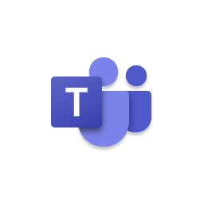
A Microsoft Teams app
Application
Microsoft Teams App Package
Web pages with server side and client-side logic
app.zip
manifest.json
Web API—for Bots and business logic
color.png
Color.png
Background Jobs
Azure Portal
Outline.png
Outline.png
Bot Framework Channel registration
Deploy & Publish your App

Slide 14
Building apps
Get Started
Define your app in App Studio
1
2
Connect your service
Embed your web app or add NL/search commands over your existing service
Automate teamwork
Plug into Graph to automate team lifecycles
3
4
Add rich comms
Integrate voice and video to light up new interactions
Publish
Submit to AppSource or your tenant’s app catalog
5

Slide 15
App Studio
Notes:
Most of you came to this conference because you have real customers that have data in Microsoft Services. Microsoft Graph is the way to access that data.

Slide 16

App Studio
App Studio
App Studio is a Teams app made for developers which:
Eliminates the need to manually craft an app package
Consolidates many registration and management experiences and reduces them down to single clicks
Provides a continually expanding set of tools such as a Card Editor to make the inner loop development process easier
Is itself built on the Teams platform and can be installed like any other app

Slide 17
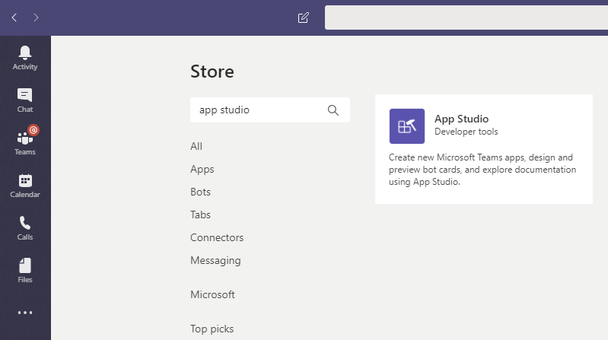
Step 1: Get App Studio from Store
In Teams, click Apps button, search for “App Studio”, install.

Slide 18
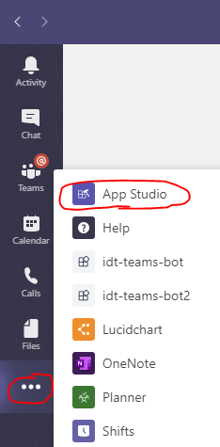
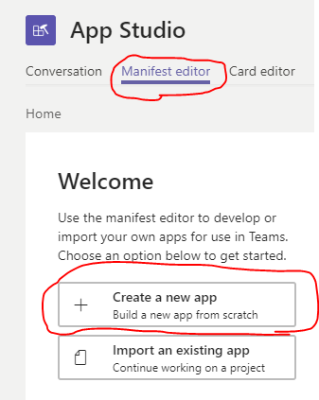
Step 2. Go to App Studio, create an app
Go to App Studio > Manifest editor > Create a new app

Slide 19
Step 3: App details
Use “idt-teams-bot” for short name, long name & short description.
Use “idt-teams-bot long description” for the long description.
Generate an App Id
Use “com.mycompany.idt.bot” for package name, “0.0.1” for version.
Use “idt-teams-bot” for Name
Use http://www.mywebsite.com for all urls.

Slide 20
Step 4: Add existing Bot
Under Capabilities->Bots choose “Set up” Existing bot.
Name: “idt-teams-bot”
Bot ID: Either “Select from one of my existing bots” if logged into the same AAD account, or “Connect to a different bot id” and paste in the Microsoft id found in the appsettings.json file of the bot.
(if connected instead of selected):
Endpoint: https://idt-teams-bot.azurewebsites.net/api/messages

Slide 21
Step 5: Add domain to validate & install
Under Finish > Valid domains, add “*.botframework.com” as a valid domain.
Under Finish > Test and distruibute, click “Install”
Choose Personal and Team checkboxes.
Click “Open” to open the Bot to begin testing.

Slide 22
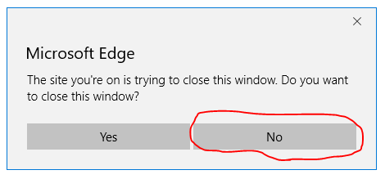
Step 6: Test your skill
Type “hi” (Bot says “Hello.”)
Type “schedule a meeting” (Bot requests a login) click “login”
Log in to your non-AAD account, but do not close the window.
A validation code will appear. Copy the code.
Paste the code into the conversation with the bot.
(follow further prompts in the conversation to set up a meeting)

Slide 23
Start Building today!
Notes:
You’ve seen today how Building Teams apps is really about leverage all the experience that you as a developer have, and bringing it into a single unified platform. Bots, cards, sites, and more.
Whether you’re an ISV, an internal developer, or a developer just getting into this space, start developing for Teams today!

Slide 24


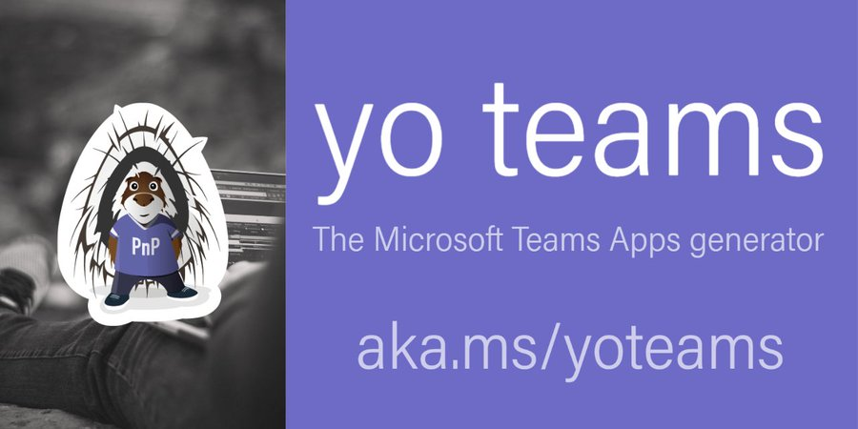
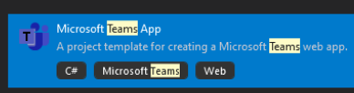
Plan your development environment
Teams Toolkit for Visual Studio Code
Typescript
React
and other JavaScript libraries
Using node
Any JavaScript libraries
Using yo teams – Yeoman Generators
Typescript
React
Teams Toolkit for Visual Studio
C#
Notes:
http://jenkinsblogs.com/2019/10/30/create-custom-microsoft-teams-messaging-extensions-using-nodejs/

Slide 25
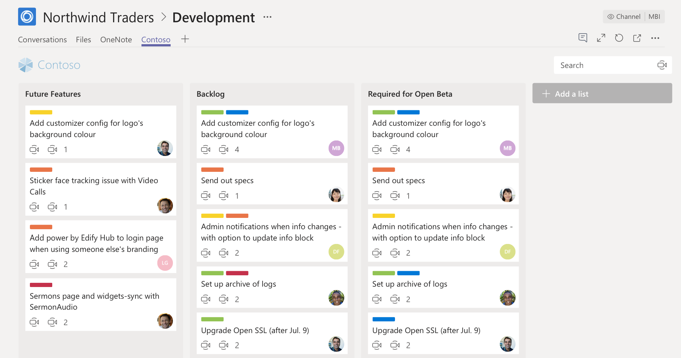
Tabs

Slide 26
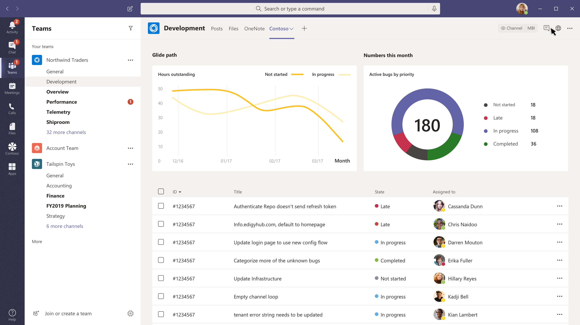
Have a conversation about work items
Tabs
When your app needs a large area to present information to users a tab is a great place to show a list of work items or a dashboard

Slide 27
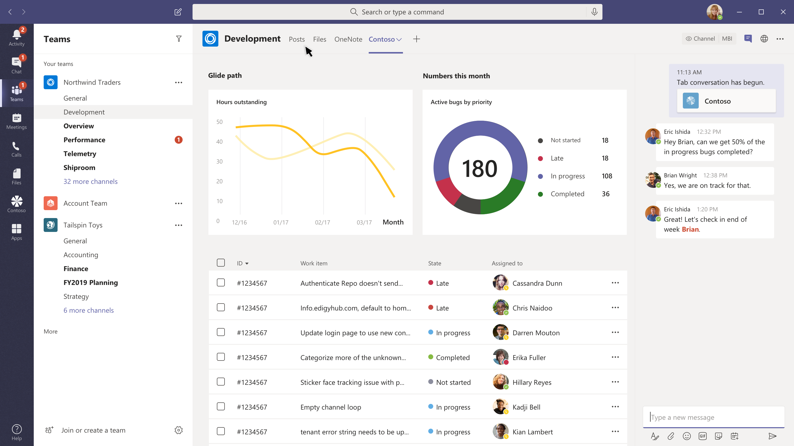
Have a conversation about work items
Tabs
When your app needs a large area to present information to users a tab is a great place to show a list of work items or a dashboard
Chat in context
Users can chat about your page, interact with it and draw people’s attention to important information all in one place

Slide 28
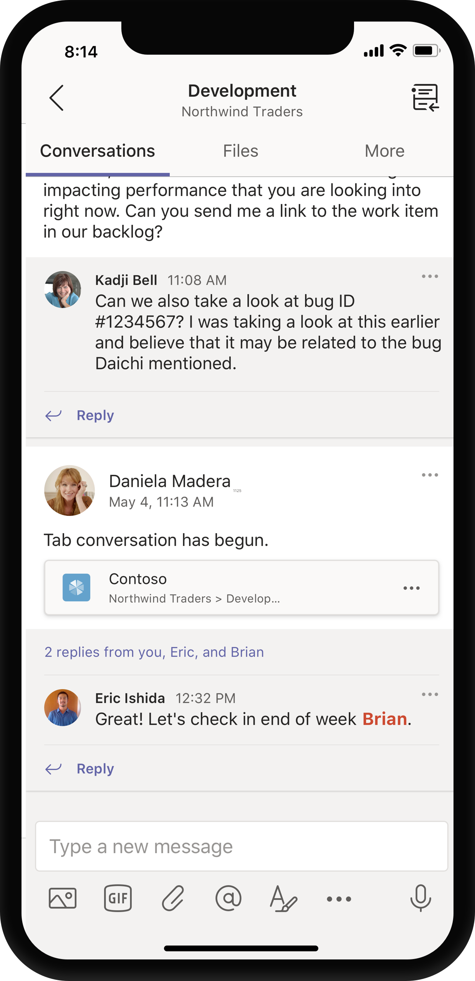
Have a conversation about work items
Tabs
When your app needs a large area to present information to users a tab is a great place to show a list of work items or a dashboard
Chat in context
Users can chat about your page, interact with it and draw people’s attention to important information all in one place
Post tab threads
Conversations within the tab will be posted in the team’s channel and promote your tab

Slide 29
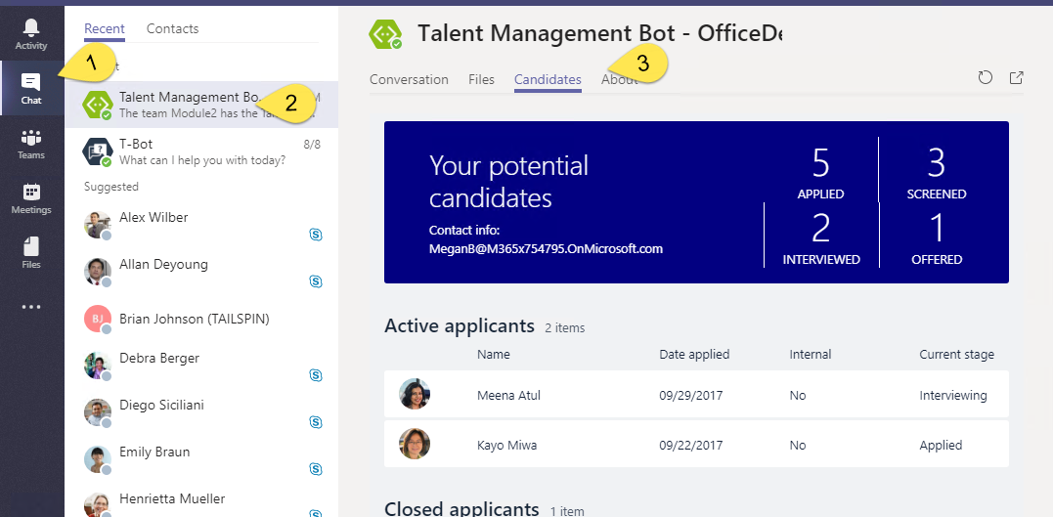
Static Tabs
A content page declared directly in manifest
No Configuration
Added in “personal” scope
Accessed via the app bar or alongside bot conversation

Slide 30
Static Tabs - Manifest
"staticTabs": [ { "entityId": "candidatesTab", "name": "Candidates", "contentUrl": "https://.../Tabs/candidates.html", "websiteUrl": "https://.../Tabs/candidates.html?web=1", "scopes": [ "personal" ] } ],
"validDomains": [ "token.botframework.com" ]
staticTabs node
contentUrl is hosted in IFRAME in Teams
websiteUrl is used as target for link
validDomains node
A list of valid domains from which the extension expects to load any content.

Slide 31
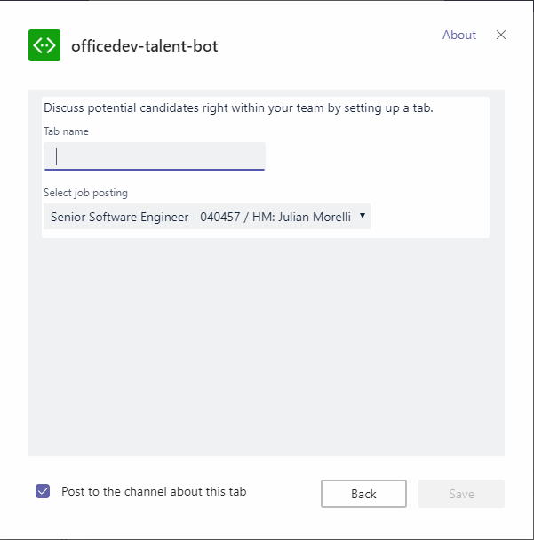
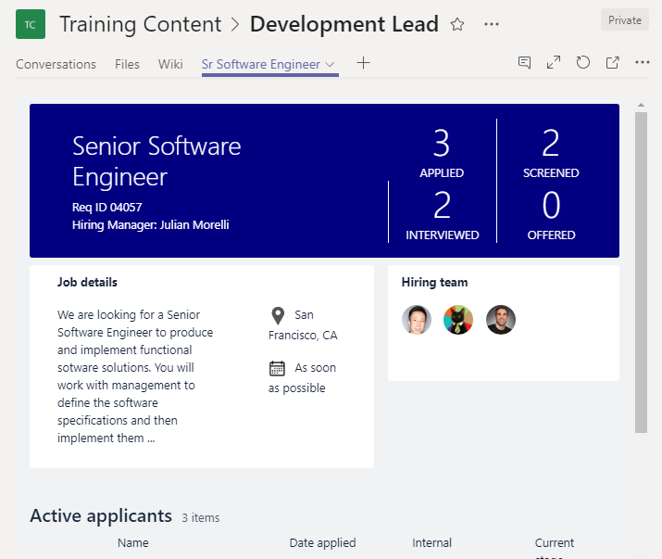
Tab Configuration and Content
Tab Configuration
Configured in manifest
Displayed when Tab added to Channel
Collect information
Call setSettings() specifying Content Url and Entity Id
Tab Content
Rendered in IFRAME
Url specified by configuration page
Inspect context for EntityId/SubEntityId
Retrieve state based on Entity/SubEntity/User
Notes:
To provide a seamless tab experience, perform provisioning and authorization on configuration page when possible.
If context has entity/subentity, then respond to a deeplink
State storage is developer’s responsibility

Slide 32
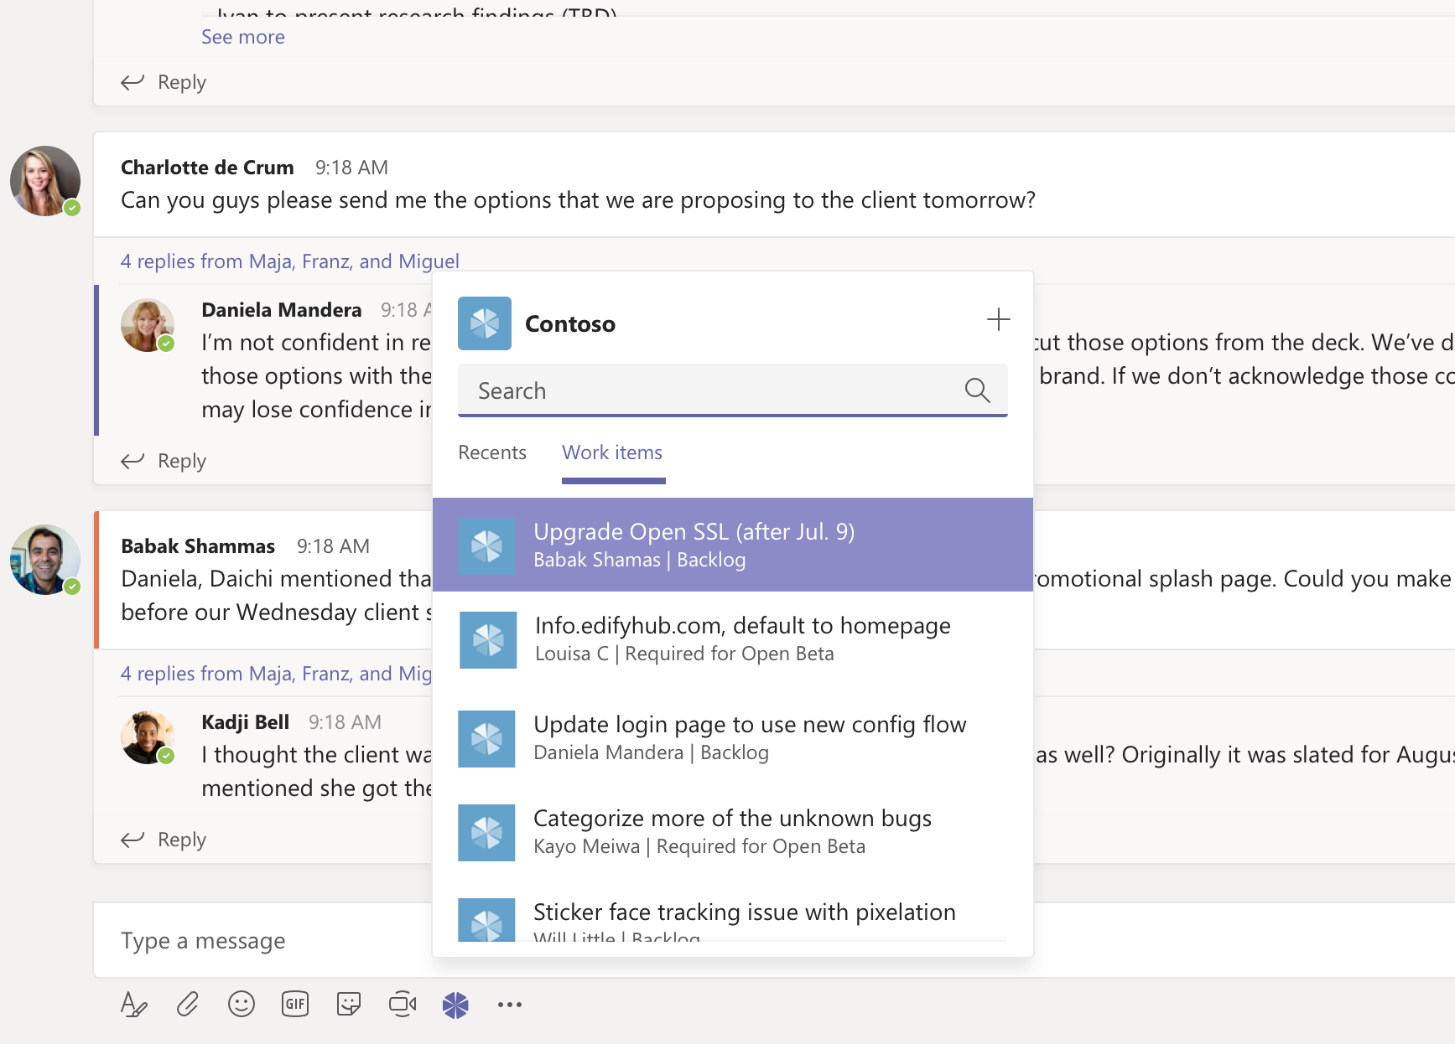
Message Extensions
&
Actions

Slide 33
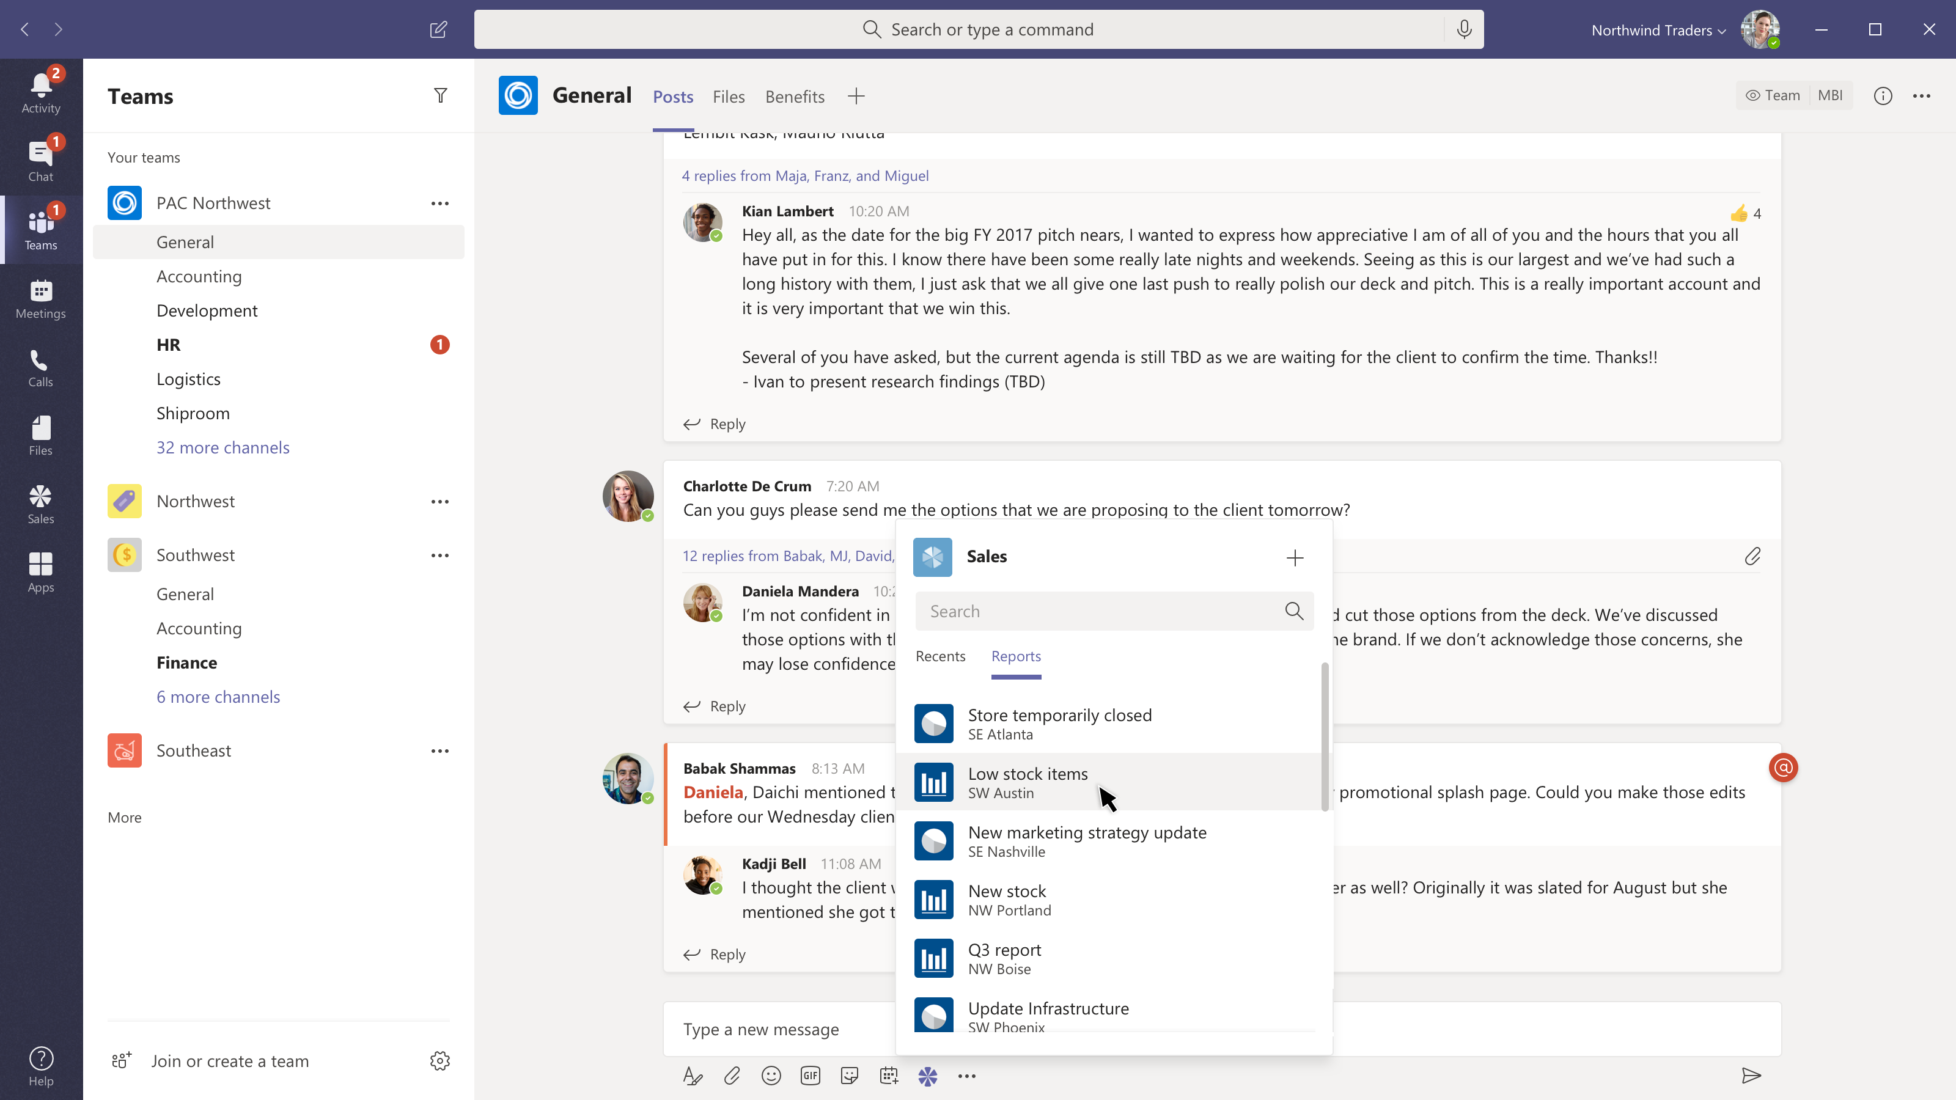
Share a sales report
Message extensions
Search for or show recently viewed reports.

Slide 34
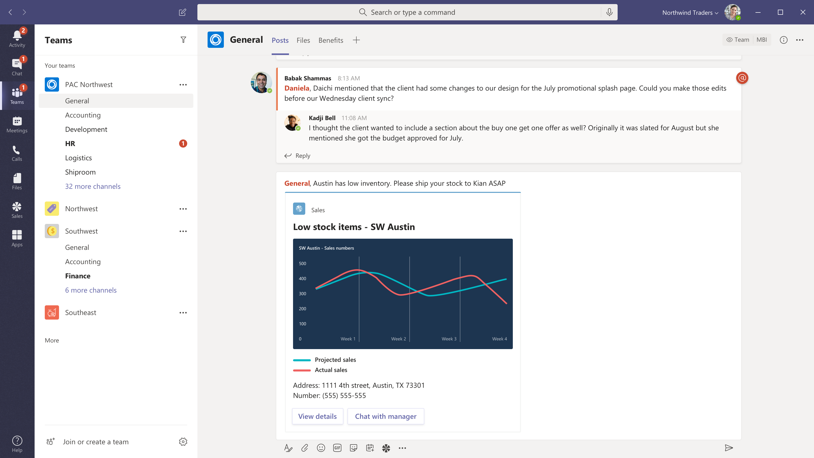
Share a sales report
Message extensions
Search for or show recently viewed reports.
Compose with card
Add comments and @mention the people who need to see the information.

Slide 35
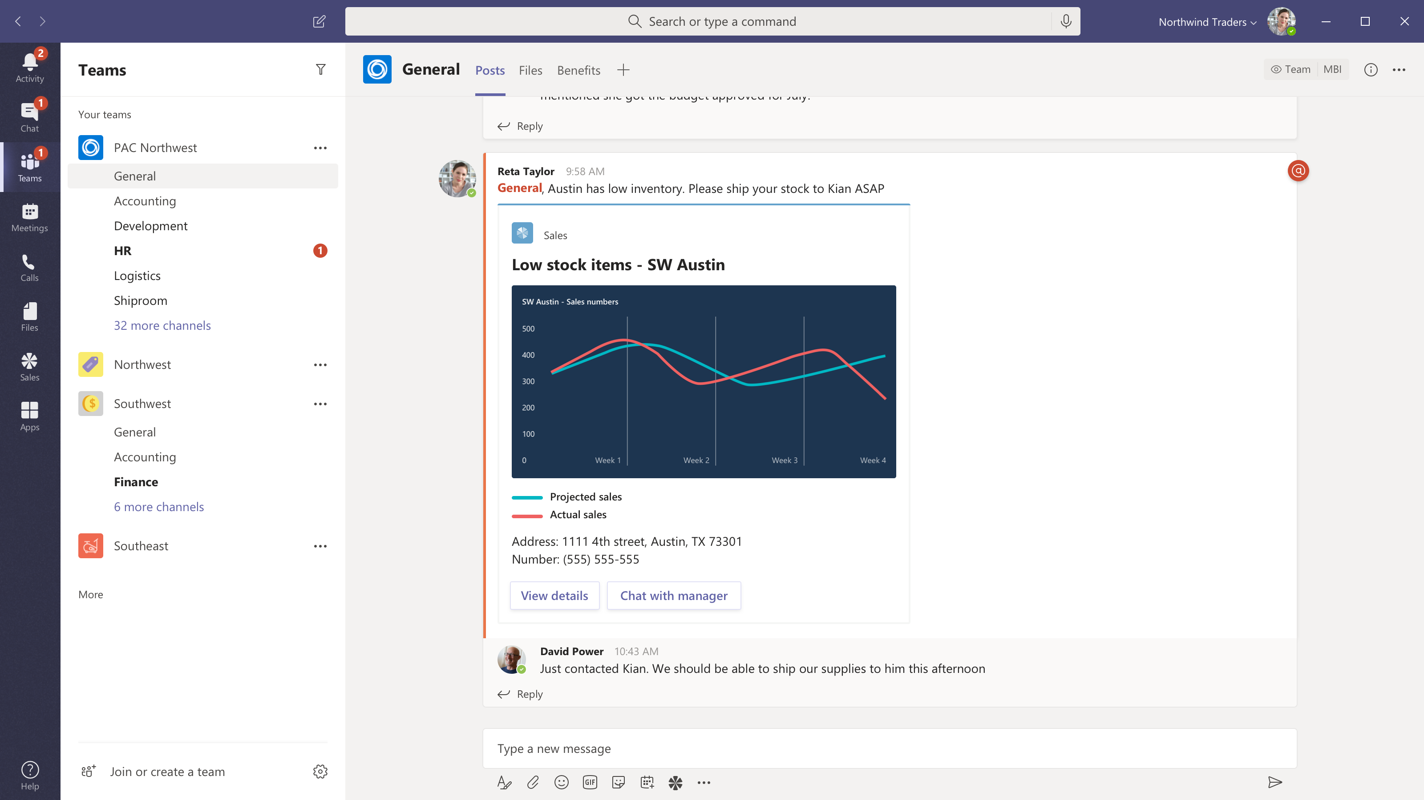
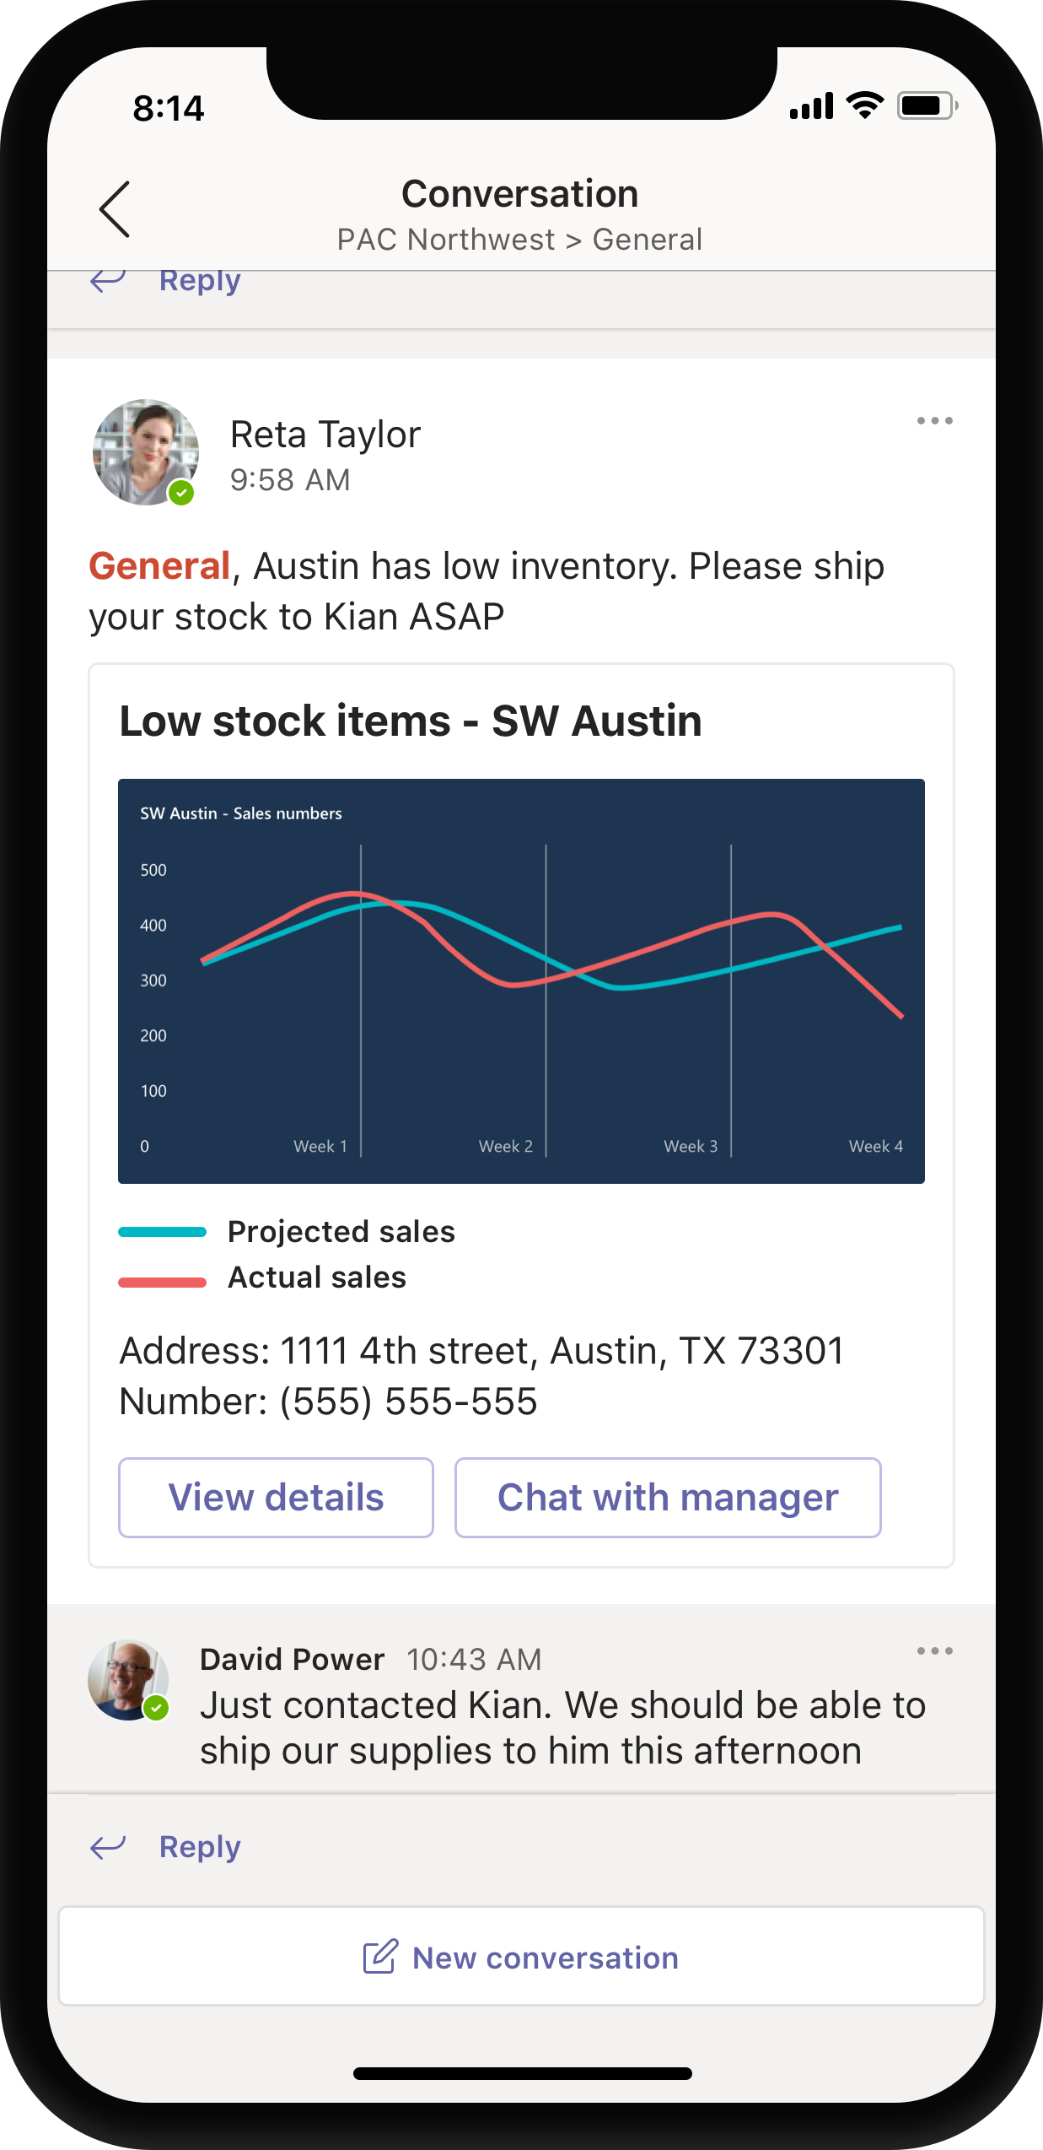
Share a sales report
Message extensions
Search for or show recently viewed reports.
Compose with card
Add comments and @mention the people who need to see the information.
Share to team
Now everyone can see the summary, open a link to your content or take immediate action right from the chat.

Slide 36
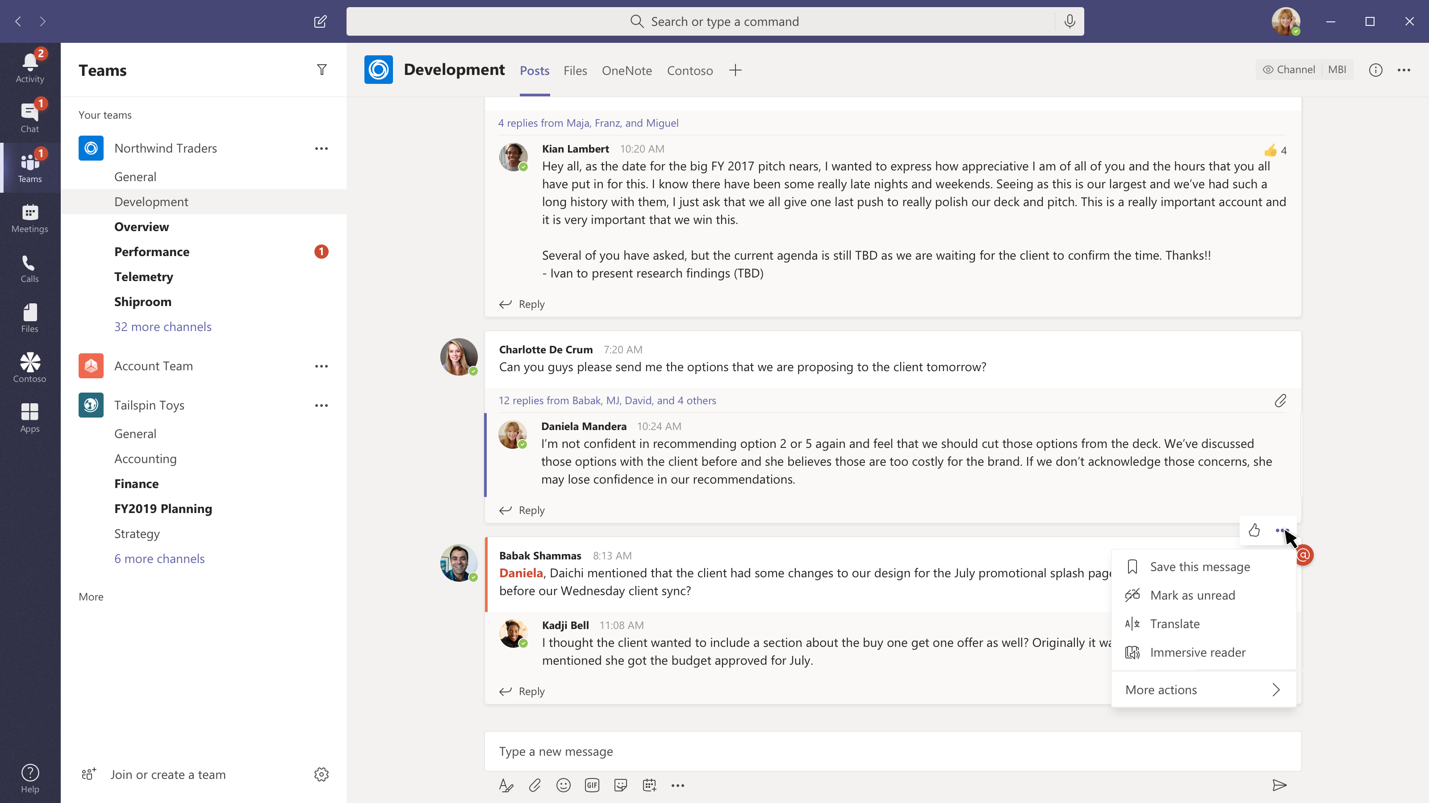
Convert chat to a sales opportunity
Message actions
Your users can send chats to your service and include time, sender information, text and if you use graph chats above and below the selection for additional context.

Slide 37
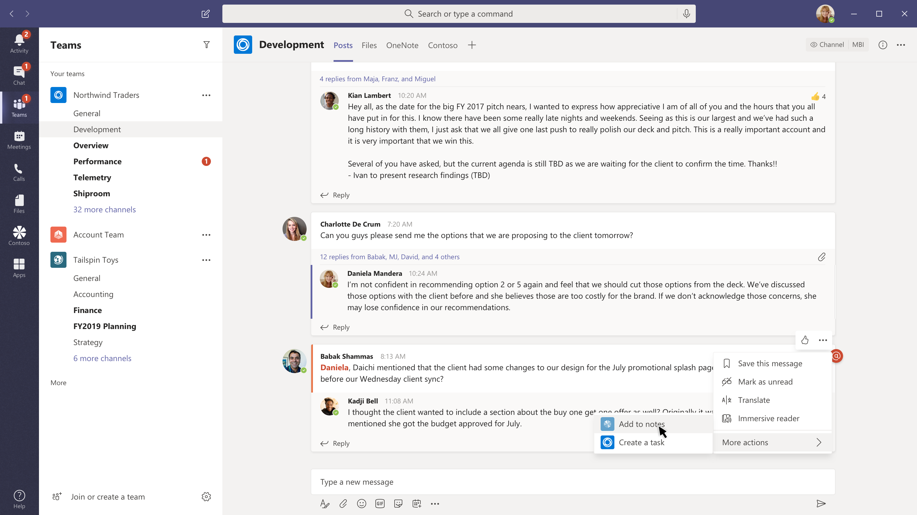
Convert chat to a sales opportunity
Message actions
Your users can send chats to your service and include time, sender information, text and if you use graph chats above and below the selection for additional context.
Tasks where the conversation is happening
Create one or more actions that appear in our context menus.

Slide 38
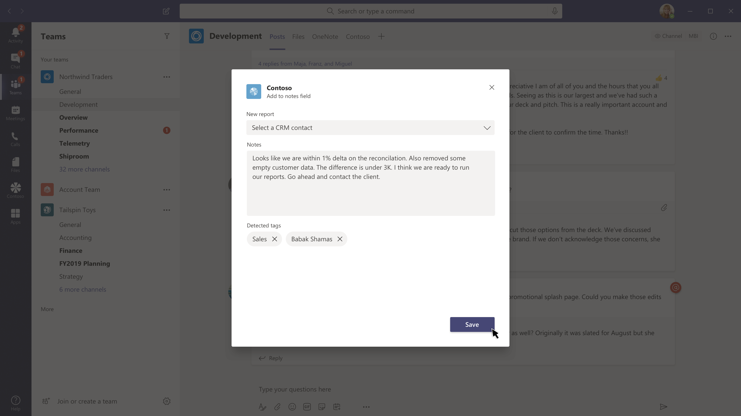
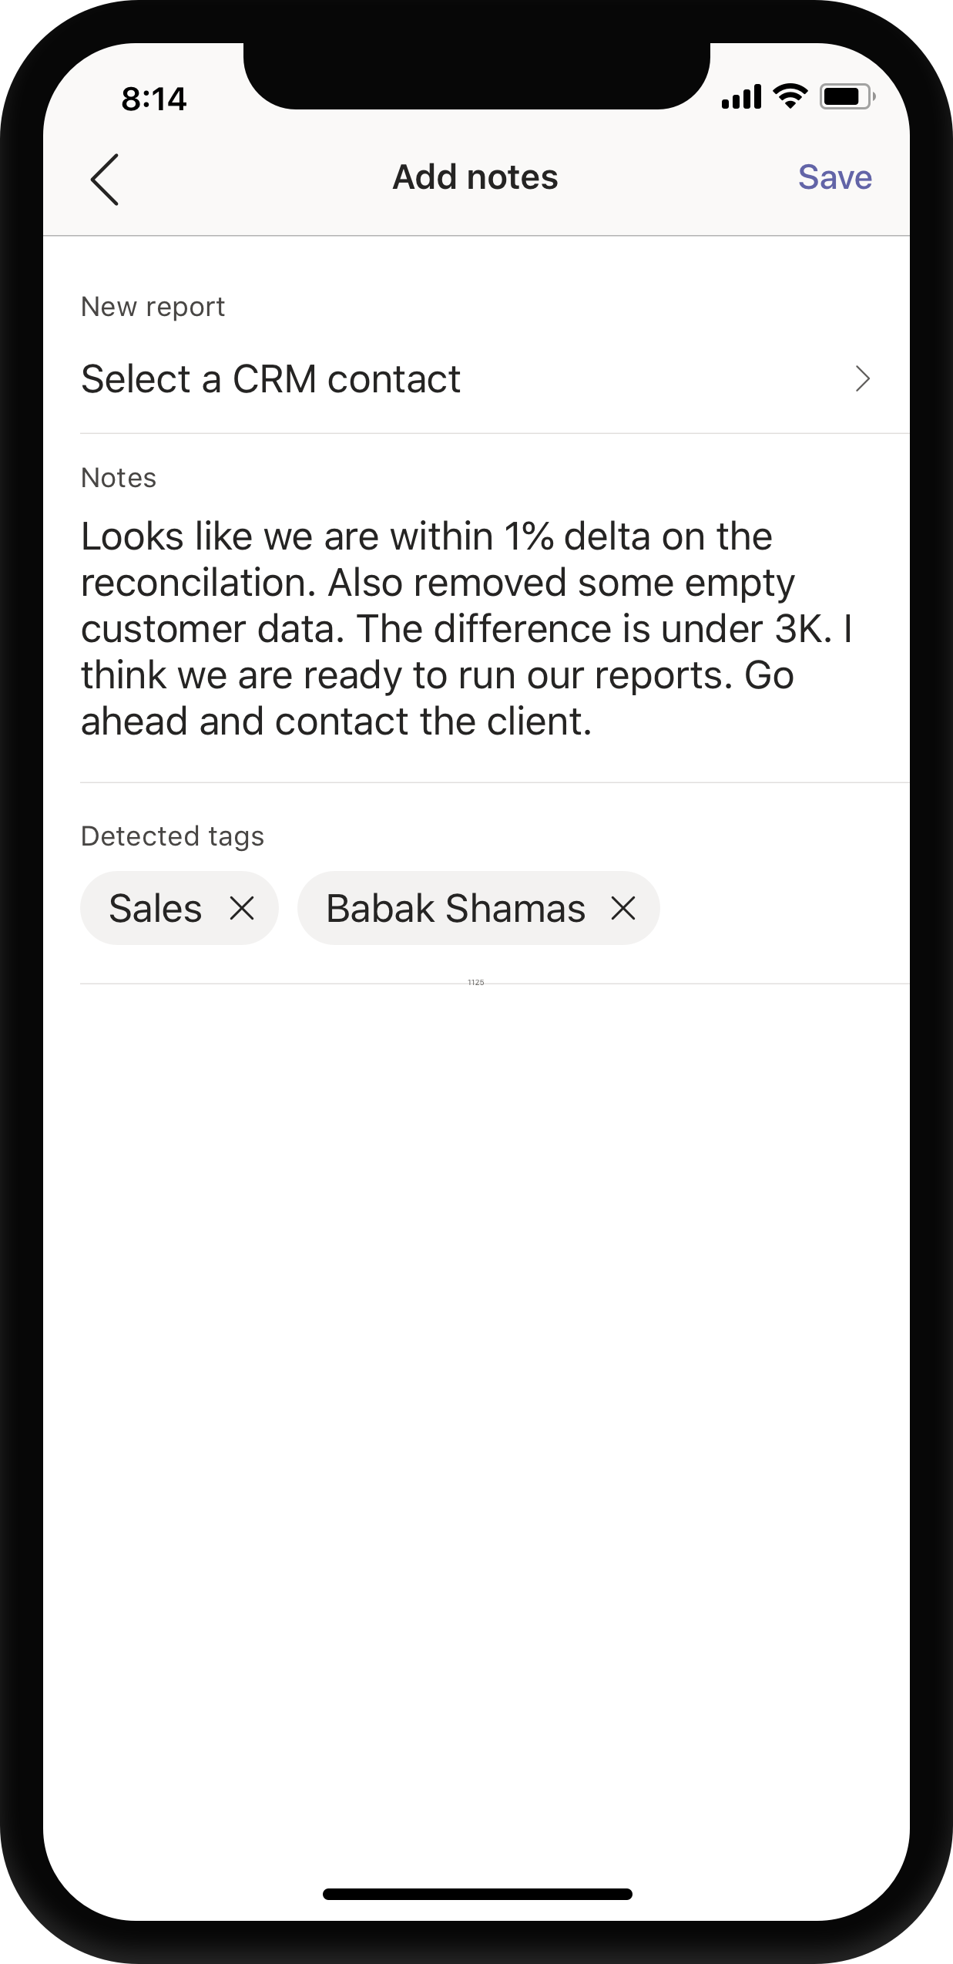
Convert chat to a sales opportunity
Message actions
Your users can send chats to your service and include time, sender information, text and if you use graph chats above and below the selection for additional context.
Tasks where the conversation is happening
Create one or more actions that appear in our context menus.
Confirm with a task module
Keeping the user in control but using natural language processing to extract the words you need to get the job done quickly and intelligently.

Slide 39
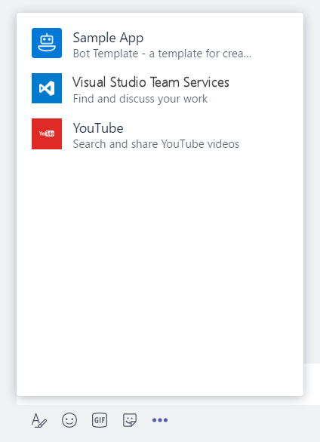
Message Extensions in App Manifest
"composeExtensions": [ { "botId": "[MicrosoftAppId]", "scopes": [ "team" ], "canUpdateConfiguration": true, "commands": [ { "id": "searchCmd", "description": "Search Bot Channels", "title": "Bot Channels", "initialRun": false, "parameters": [ { "name": "searchText", "description": "Enter your search text", "title": "Search Text“ } ] } ] } ]
composeExtension node
Associated with a registered application
Personal and Team scopes
Define command UI and parameter
Multiple extensions
Your extension shown along with all others added to Teams
Notes:
commandExtension is part of the manifest.json file
Scope determines if 1:1 (personal) or channel (team)

Slide 40
Creating Message Action from Extension
"composeExtensions": [
{
"botId": "57a3c29f-1fc5-4d97-a142-35bb662b7b23",
"canUpdateConfiguration": true,
"commands": [
{
"id": "reassignTodo",
"description": "Reassign a todo item",
"title": "Create To Do",
"type": "Action",
"context": ["message"],
"fetchTask": true
}]

Slide 41
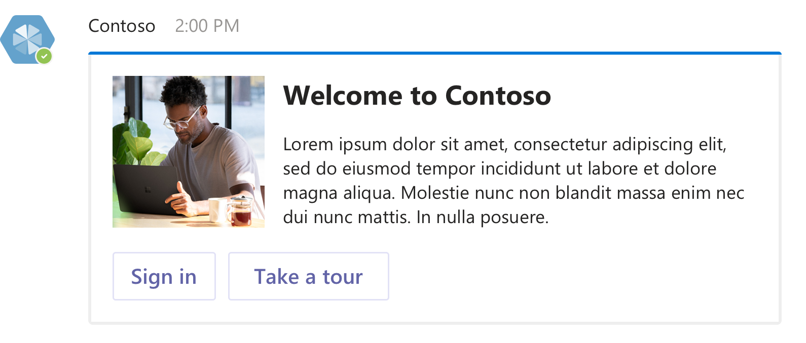
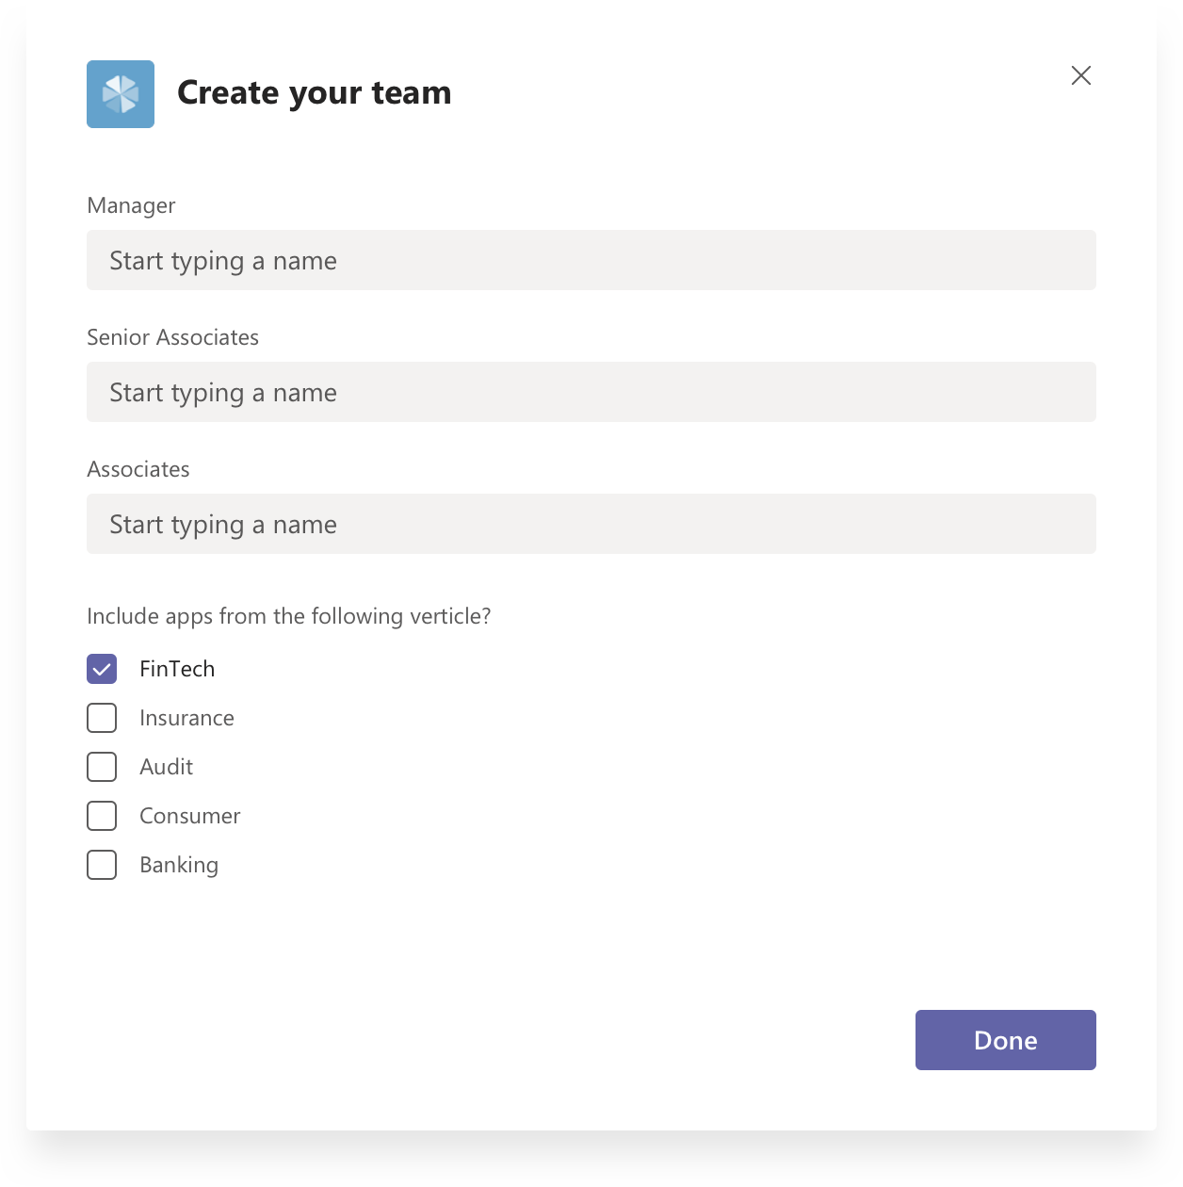
Bots & Task Modules

Slide 42
Conversations
Series of messages sent between your bot and one or more users. Conversations are in one of the following scopes:
Teams
Also called channel conversations, visible to all members of the channel.
Personal
Conversations between bots and a single user.
Group chat
Chat between a bot and two or more users.

Slide 43
Notification only bots
"bots": [ { "botId": "[MicrosoftAppId]", "scopes": [ "personal", "team" ], "isNotificationOnly": true, } ]
Bots can update the activity feed
If the sole purpose of the bot is to deliver notifications, consider a notification only bot.
Users cannot message your notification-only bot
Users cannot @mention the bot
bots node
isNotificationOnly property

Slide 44
Send and Receive file
Sending and receiving files through a bot can be accomplished via two different APIs
Microsoft Graph API
Obtain access to OneDrive folder (user or group drive)
Get reference to file
Post message to conversation with card attachment
Microsoft Teams API
Personal context (1:1) only
Enable files in manifest
Teams client provides a file picker experience
Teams client will store file in OneDriveCreate and then post activity with metadata, including content URL
Bot must download and handle file as appropriate
Notes:
Personal conversation requires User Id (from Teams) and Tenant Id

Slide 45
Enable send and receive
"bots": [ { "botId": "[MicrosoftAppId]", "scopes": [ "personal", "team" ], "supportsFiles": true, } ]
Teams client will handle file selection and storage
Handles scenario User -> Bot
bots node
supportsFiles property

Slide 46
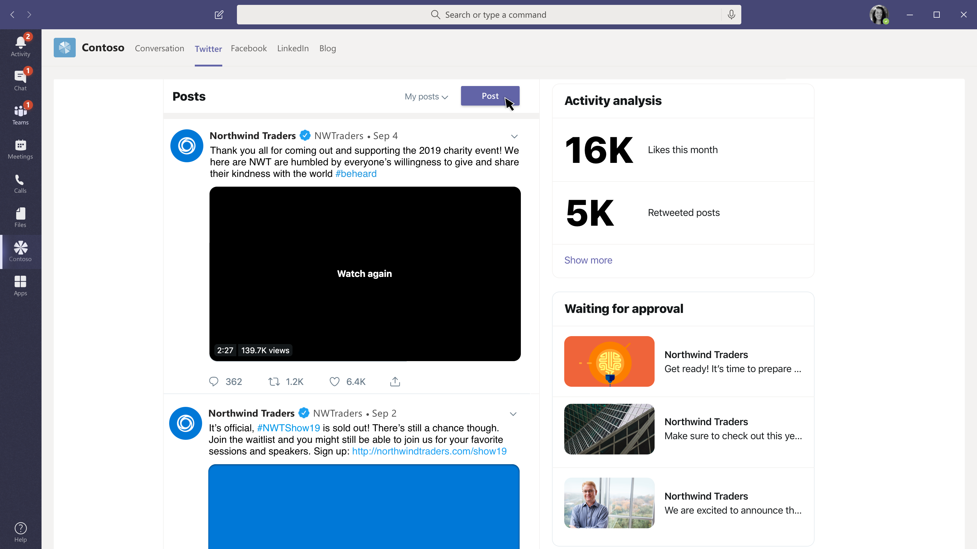
Submit a social media post for approval
Social media dashboard
A great view of my company’s social media engagement and how we are trending

Slide 47
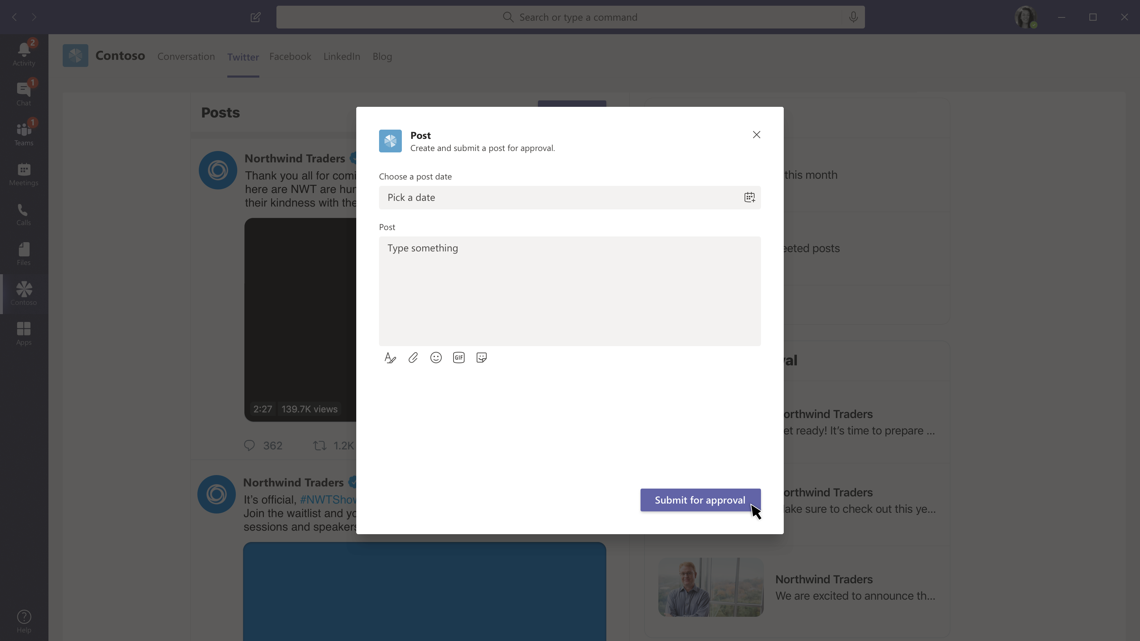
Submit a social media post for approval
Social media dashboard
A great view of my company’s social media engagement and how we are trending
Submit a post for approval
Approval workflows get routed to the right team for quick review and automated posting to your corporate social media accounts

Slide 48
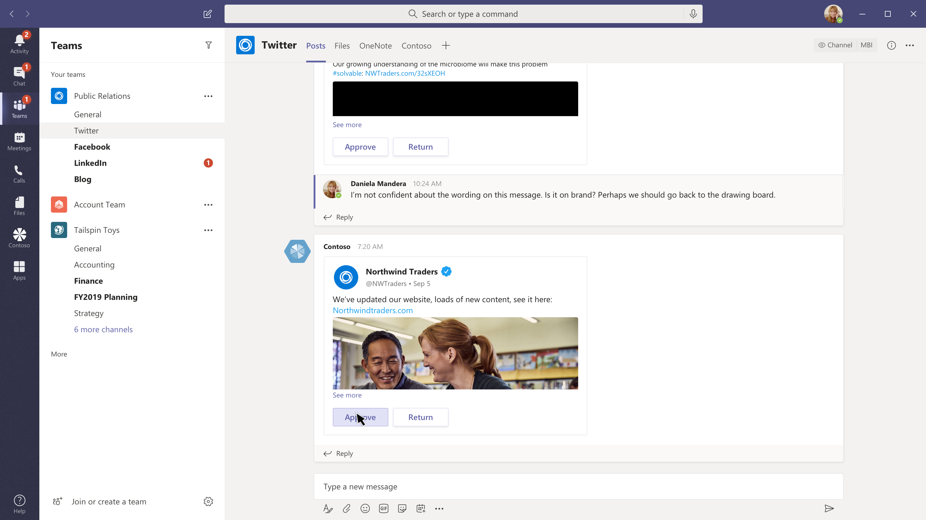
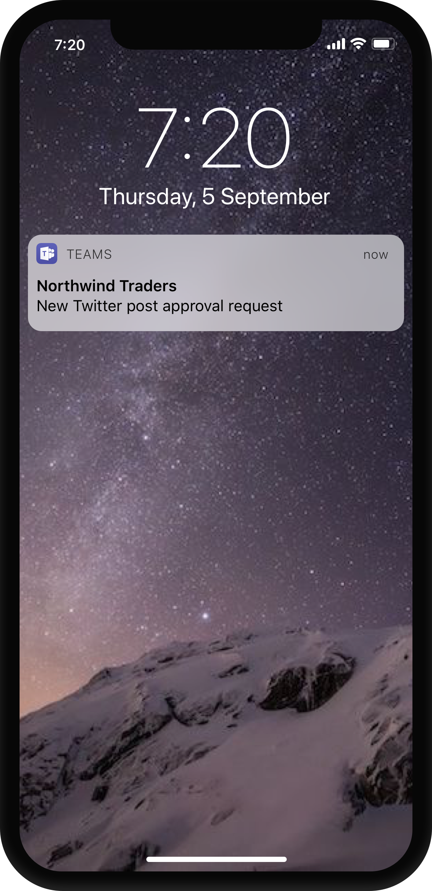
Submit a social media post for approval
Social media dashboard
A great view of my company’s social media engagement and how we are trending
Submit a post for approval
Approval workflows get routed to the right team for quick review and automated posting to your corporate social media accounts
Notify the right team
Approval workflows get routed to the right team for quick review and automated posting to your corporate social media accounts

Slide 49
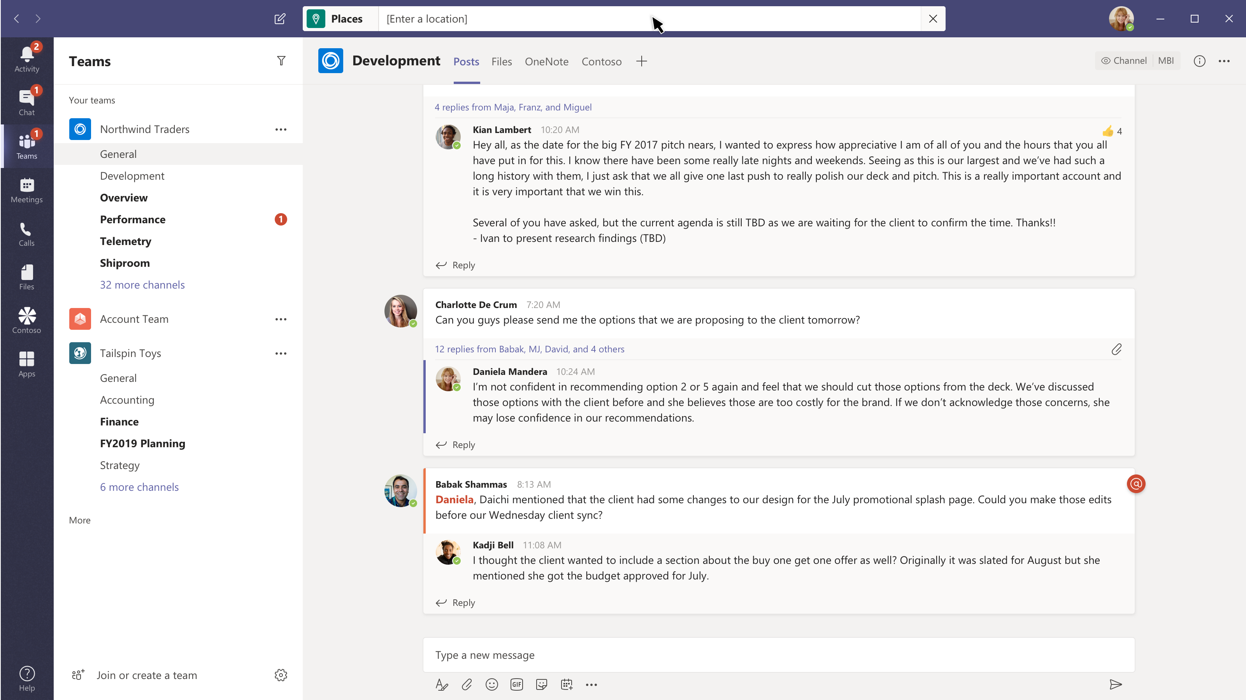
Look up a place to eat
Find a restaurant without losing your place
@mentioning your app in the command box gives users global access to your app, while they are anywhere in teams.

Slide 50
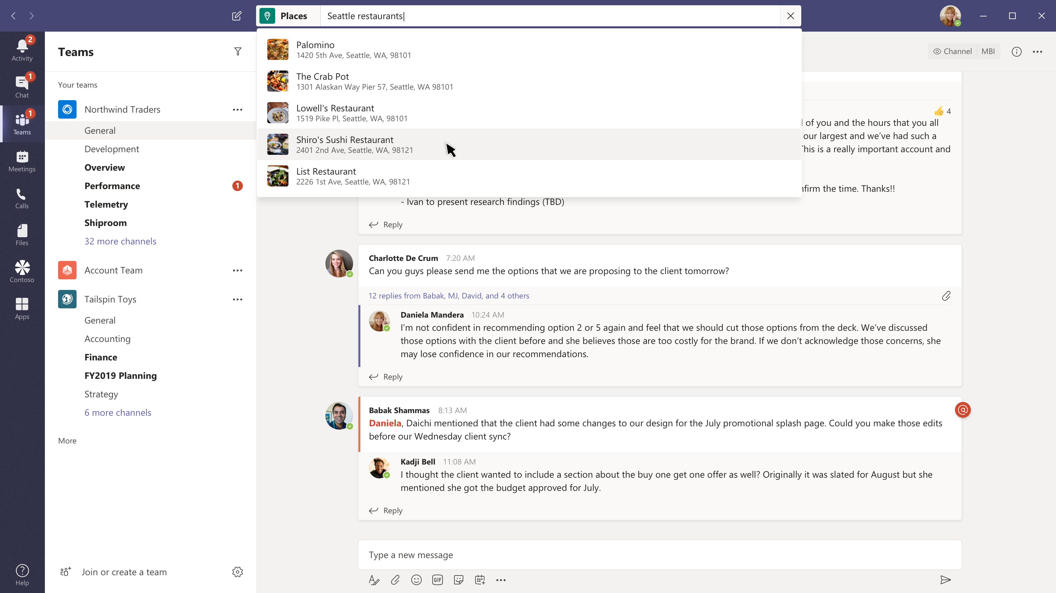
Look up a place to eat
Find a restaurant without losing your place
@mentioning your app in the command box gives users global access to your app, while they are anywhere in teams.
Search with one or more parameters
You can make your app incredibly powerful with single parameter or multi parameter queries, and even default queries you save for everyone or per user.

Slide 51
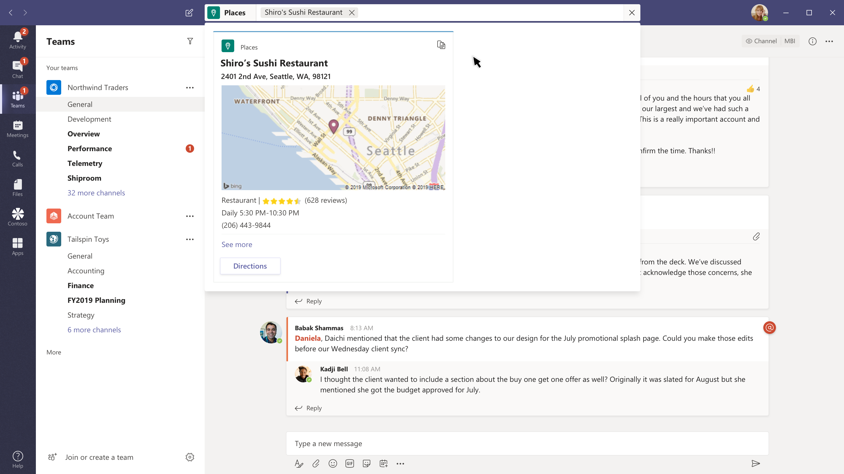
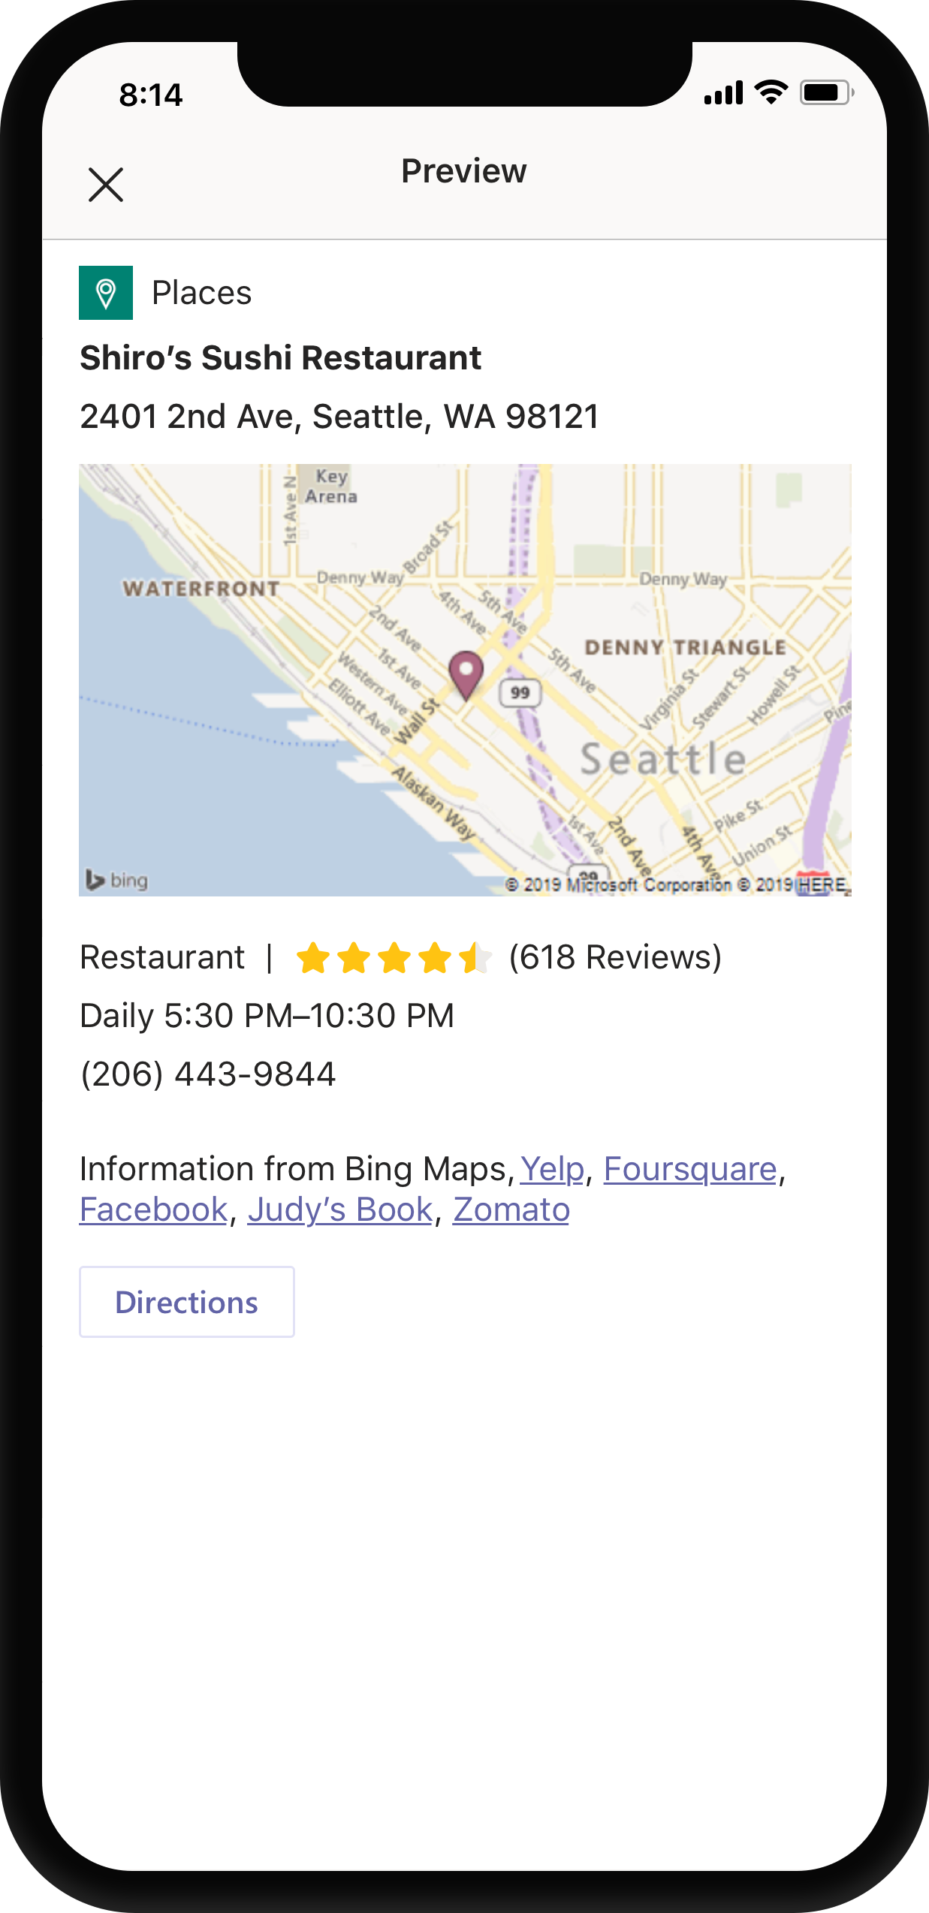
Look up a place to eat
Find a restaurant without losing your place
@mentioning your app in the command box gives users global access to your app, while they are anywhere in teams.
Search with one or more parameters
You can make your app incredibly powerful with single parameter or multi parameter queries, and even default queries you save for everyone or per user.
Share
Users can get the information they need and get back to work or share your card with others.

Slide 52
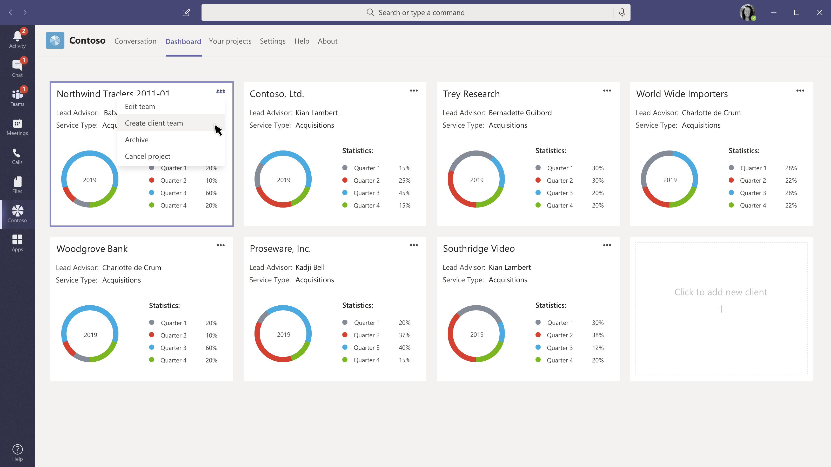
Create a team, add members, and a message
Kicking off a new project can be easier
Using Teams templates and your app you can automate the onboarding process.

Slide 53
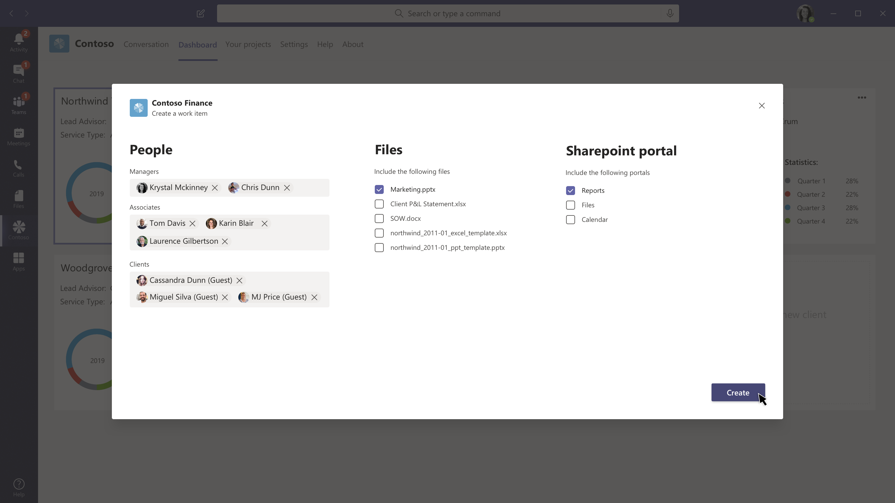
Create a team, add members, and a message
Kicking off a new project can be easier
Using Teams templates and your app you can automate the onboarding process.
Simplify known workflows
Select users who will be team owners vs team members to comply with access and role limitations, pick documents in your service or on SharePoint to add to the mix. Add a welcome message.

Slide 54
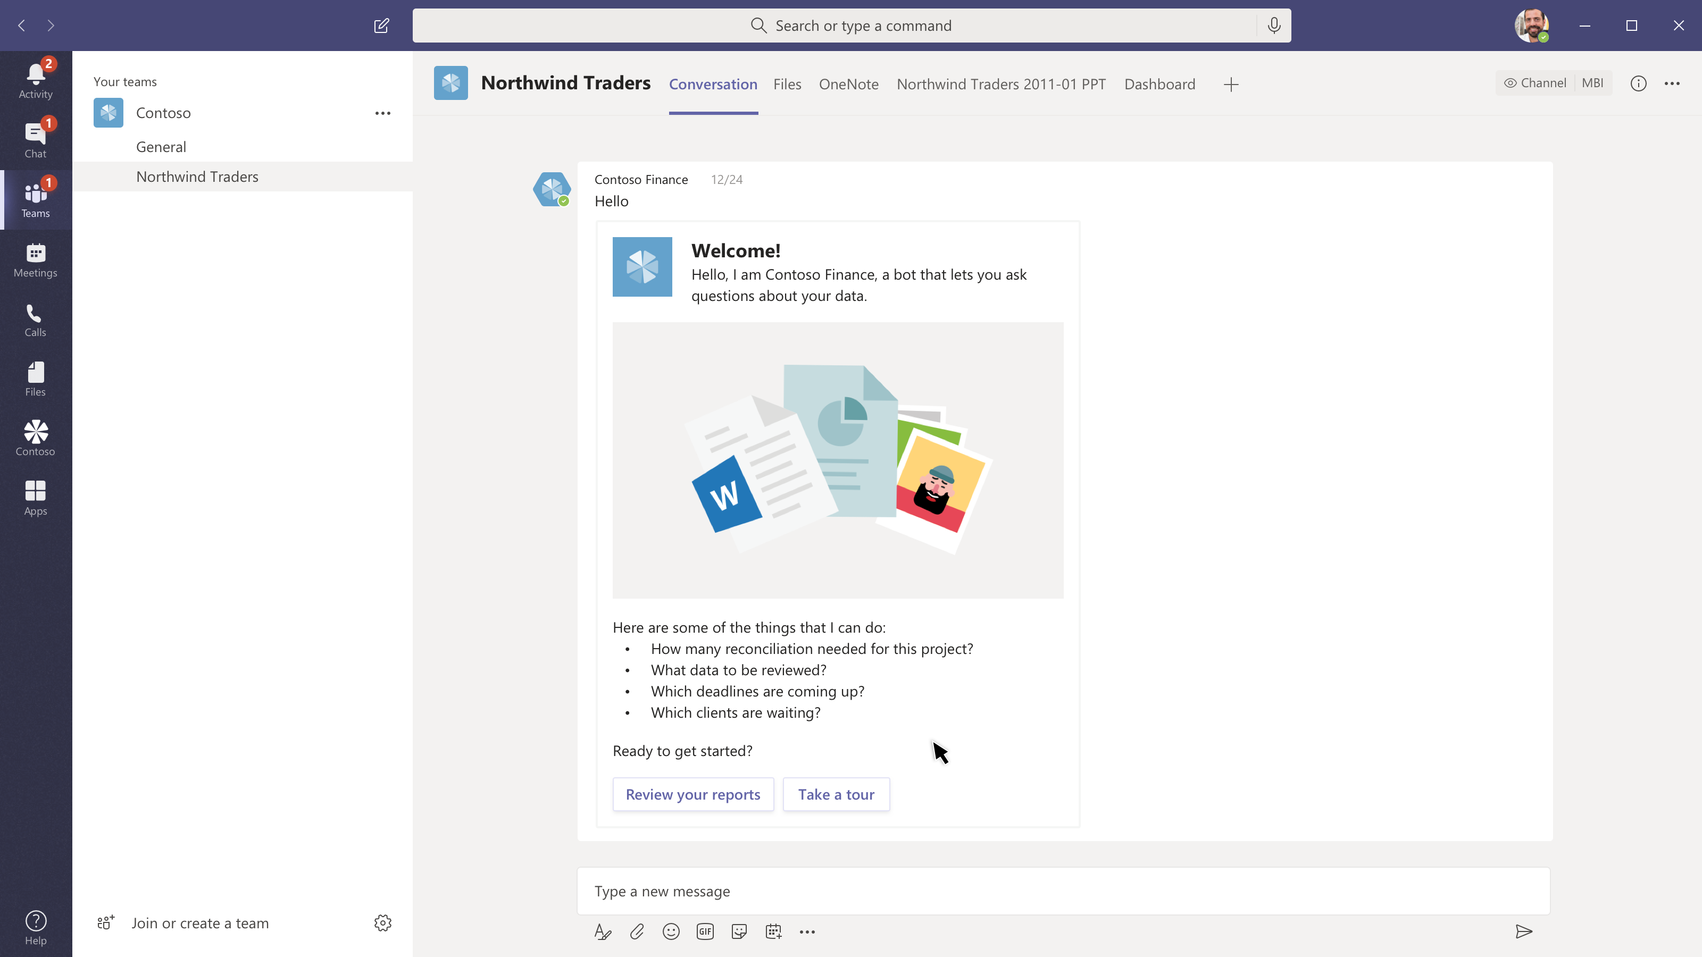
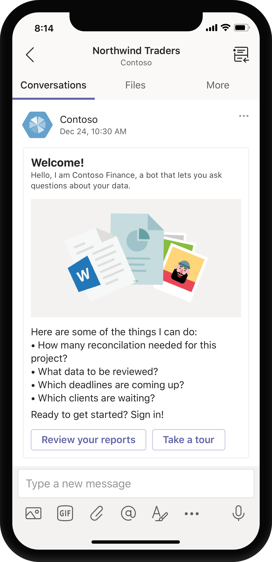
Create a team, add members, and a message
Kicking off a new project can be easier
Using Teams templates and your app you can automate the onboarding process.
Simplify known workflows
Select users who will be team owners vs team members to comply with access and role limitations, pick documents in your service or on SharePoint to add to the mix. Add a welcome message.
Bot notification
In the new team we start the project knowing what we are doing and where everything is.

Slide 55
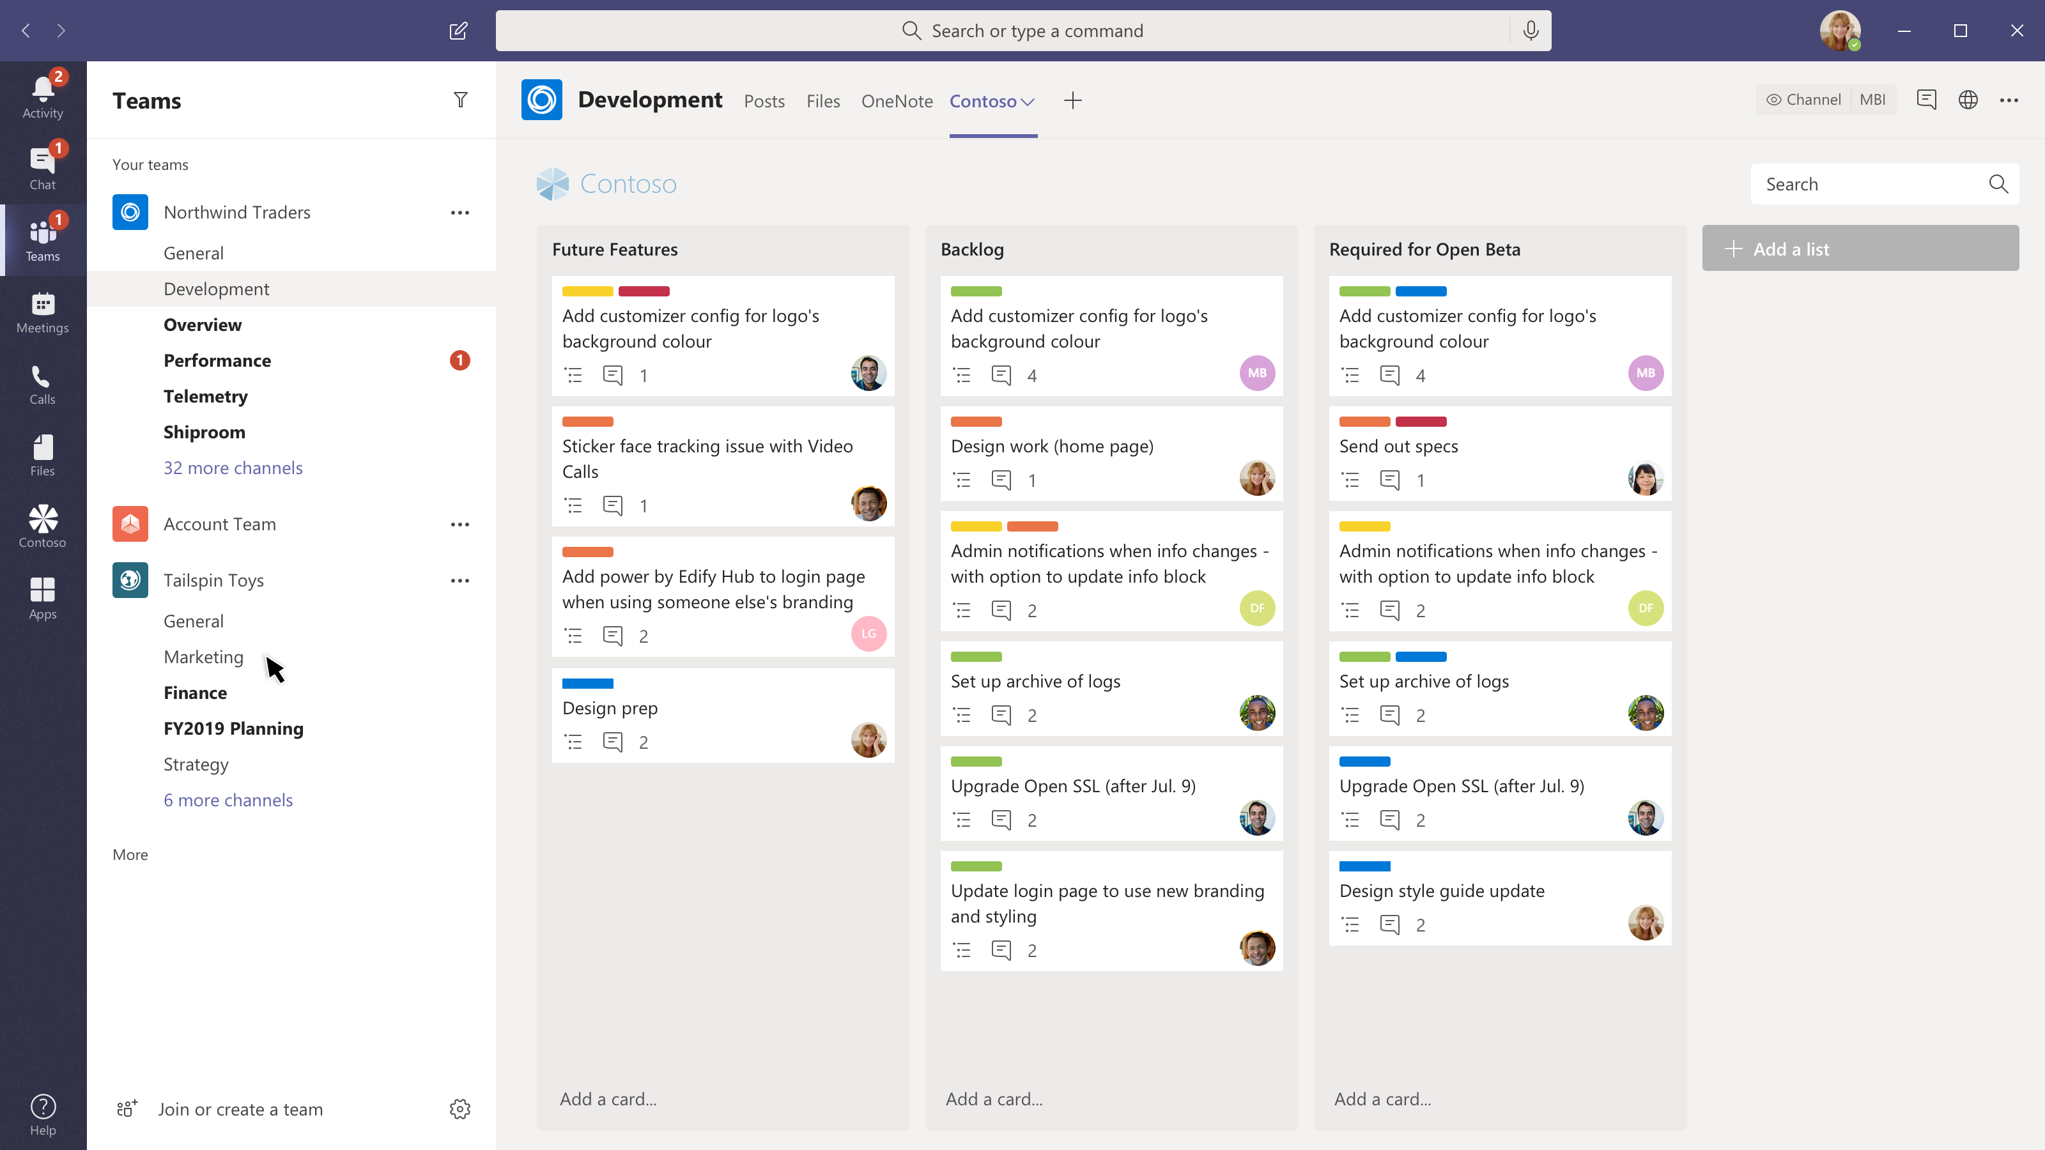
Your “task” hub
The Development channel has some tasks for Daniella
This is a project with specific goals and work items.

Slide 56
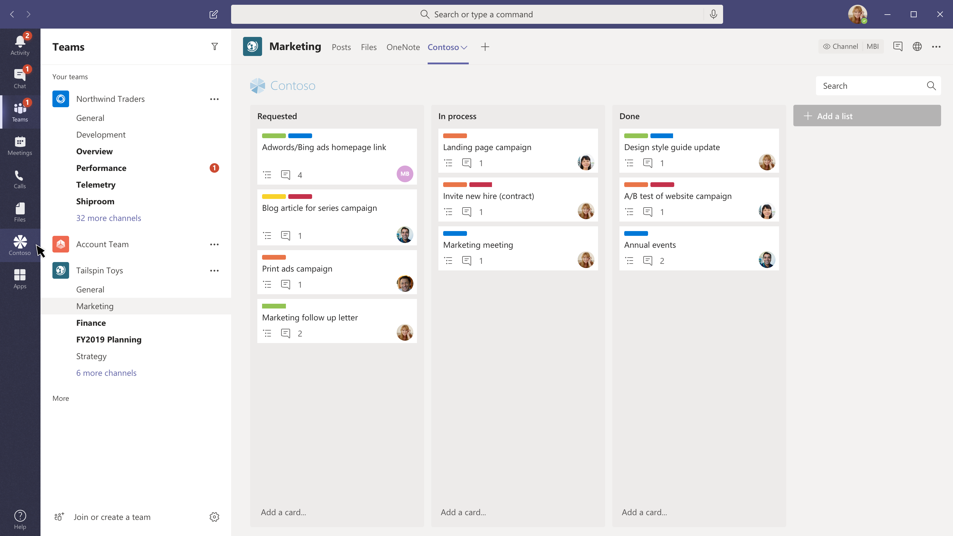
Your “task” hub
The Development channel has some tasks for Daniella
This is a project with specific goals and work items.
The Marketing channel is in another team
But Daniella has things she needs to do here too.

Slide 57
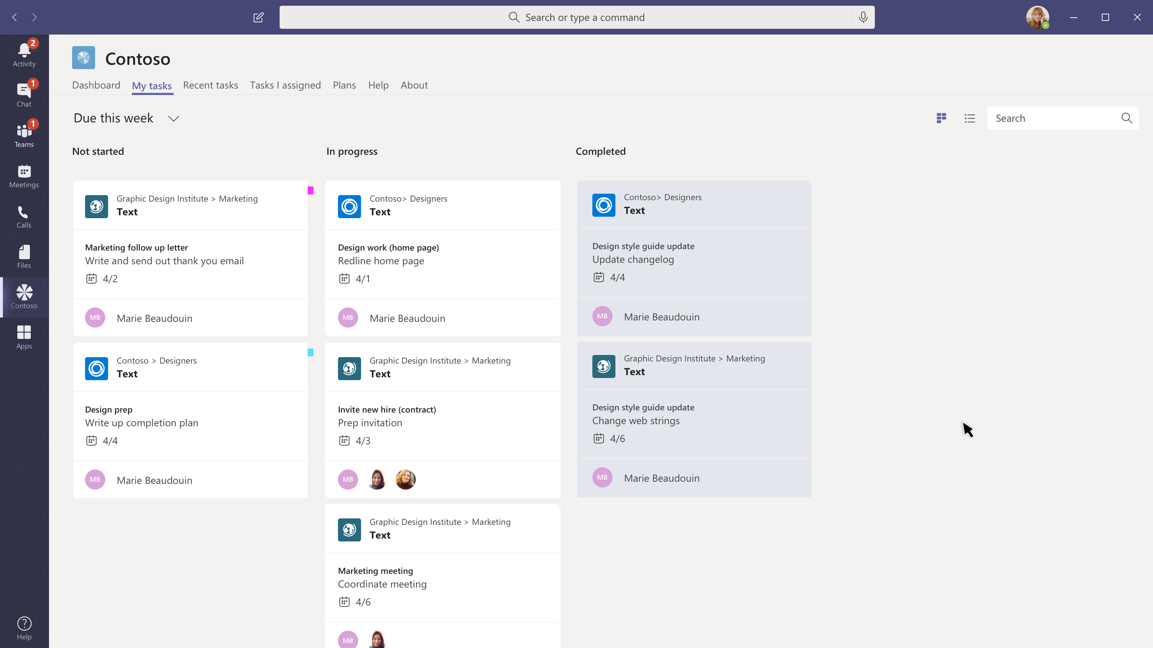
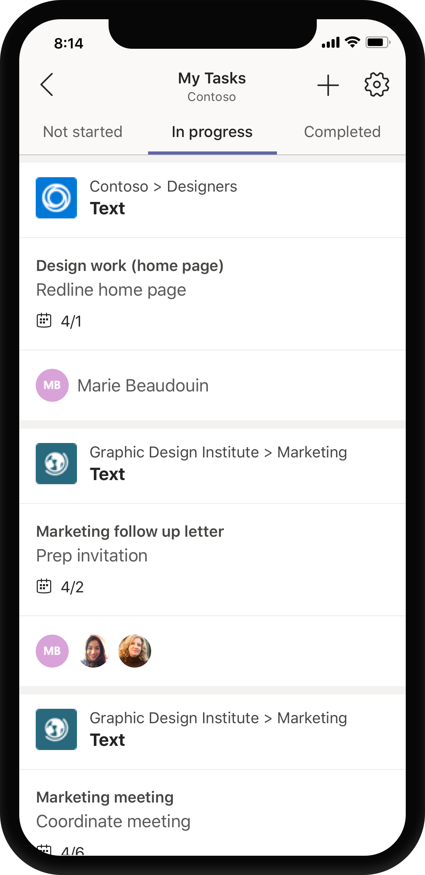
Your “task” hub
The Development channel has some tasks for Daniella
This is a project with specific goals and work items.
The Marketing channel is in another team
But Daniella has things she needs to do here too.
Personal apps can create a unified view
Daniella will likely start her day here, and it’s a great place to see all the work she has to do in one place… with handy links to take her to the channels where she needs to collaborate

Slide 58
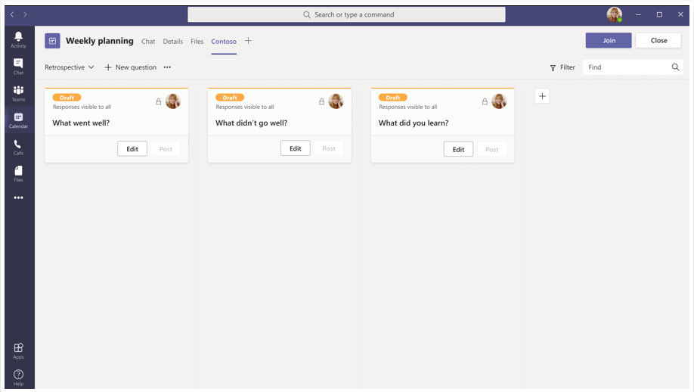
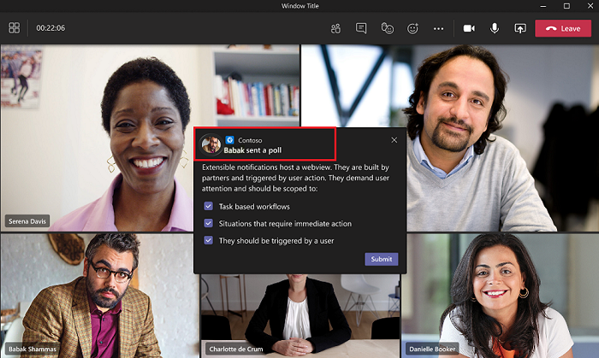
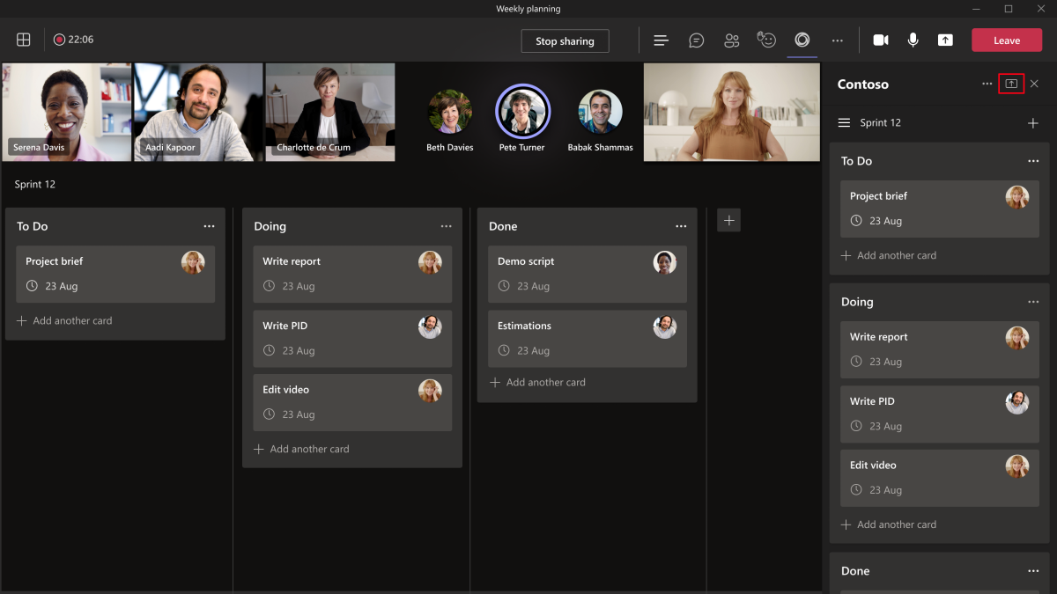

Meeting Apps

Slide 59

Meeting Apps extensibility

Slide 60
Unified meetings apps concept
Meeting Stages
Pre-meeting
In-meeting
Post-meeting
Participant Roles in meetings
Organizer
Presenter
Attendee
User types in a meeting
In-tenant
guest
Federated or external
Anonymous

Slide 61
Unified meetings apps concept
User type | Tabs | Bots | Message extensions | Adaptive Cards | Task modules | In-meeting dialog | Meeting stage
Anonymous user | Not available | Not available | Not available | Interactions in the meeting chat are allowed. | Interactions in the meeting chat from Adaptive Card are allowed. | Not available | Not available
Guest, part of the tenant Azure AD | Interaction is allowed. Create, update, and delete aren't allowed. | Not available | Not available | Interactions in the meeting chat are allowed. | Interactions in the meeting chat from Adaptive Card are allowed. | Available | Can start, view, and interact with app on the meeting stage only on Teams desktop client
Federated Users | Interaction is allowed in scheduled meetings. Create, update, and delete aren't allowed. | Interaction is allowed. Acquire, update, and delete aren't allowed. | Not available | Interactions in the meeting chat are allowed. | Interactions in the meeting chat from Adaptive Card are allowed. | Not available | Can start, view, and interact with app on the meeting stage only on Teams desktop client.

Slide 62
Enable your app for Teams meetings
Tab
Bot
Messaging extension
Value | Description
channelTab | A tab in the header of a team channel.
privateChatTab | A tab in the header of a group chat between a set of users, not in the context of a team or meeting.
meetingChatTab | A tab in the header of a group chat between a set of users for a scheduled meeting. You can specify either meetingChatTab or meetingDetailsTab to ensure the apps work in mobile.
meetingDetailsTab | A tab in the header of the meeting details view of the calendar. You can specify either meetingChatTab or meetingDetailsTab to ensure the apps work in mobile.
meetingSidePanel | An in-meeting panel opened through the unified bar (U-bar).
meetingStage | An app from the meetingSidePanel can be shared to the meeting stage. You can't use this app either on mobile or Teams room clients.
Meeting Stages
Apps in meetings require groupchat scope. The team scope works for tabs in channels only.
Apps in meetings can use the following contexts: meetingChatTab, meetingDetailsTab, meetingSidePanel and meetingStage.

Slide 63
Configure your app for meeting scenarios
Before a meeting
Tab
During a meeting
Meeting Side Panel
In-meeting notification
Shared meeting stage
Share specific parts of the app to stage
After a meeting
Tab
"configurableTabs": [
{
"configurationUrl": "https://contoso.com/teamstab/configure",
"canUpdateConfiguration": true,
"scopes": [
"team",
"groupchat"
],
"context":[
"channelTab", //team
"privateChatTab",
"meetingChatTab",
"meetingDetailsTab",
"meetingSidePanel",
"meetingStage"
]
}
]
*The configurations of after and before meetings are the same.

Slide 64

Limitations
Currently, adding an app is not supported in mobile. However, a user can view the app and share the app to stage from mobile.
Currently when a third person is added to a one-on-one call, the call is elevated to a group call that means a new session starts. Apps added to the one-on-one call are not available in the group call. However, they can be added again.
Currently app experiences are not supported in Teams channel meetings (both scheduled meetings and instant meetings).
Federated users can't interact with tab apps in calls.

Slide 65

Publish your app to your organization

